Slide 1
Virtual Reality (VR) Automated Testing in the Wild: A Case Study on Unity-Based VR Applications
Authors:
Dhia Elhaq Rzig, University of Michigan - Dearborn
Nafees Iqbal, University of Michigan - Dearborn
Isabella Attisano, Villanova University
Xue Qin, Villanova University
Foyzul Hassan, University of Michigan - Dearborn
Notes:
Ph.D candidate, finishing my 3rd Year at UM Dearborn,
Done in collaboration with my supervisor,
2 from MSR, Nagappan is now with Meta

Slide 2
Outline
Introduction
Background
Research Approach
Empirical Evaluation
Implications
Conclusion

Slide 3
Introduction

Slide 4
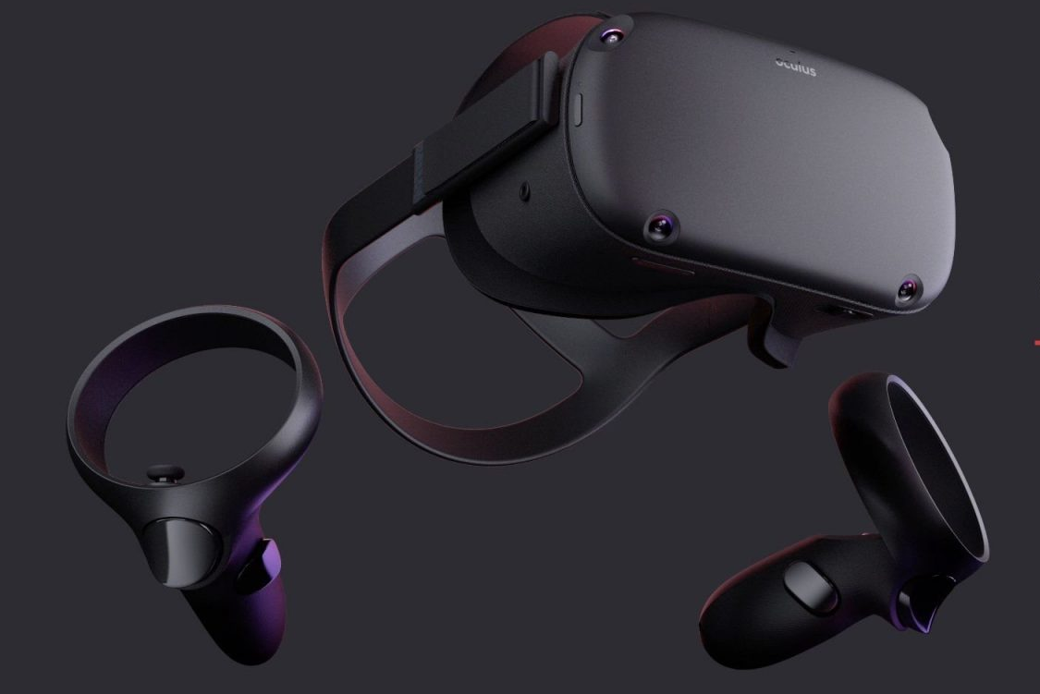
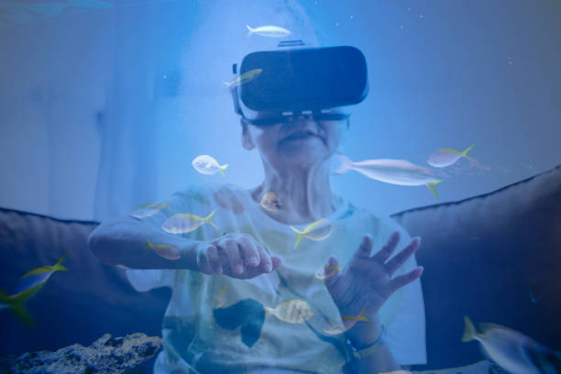
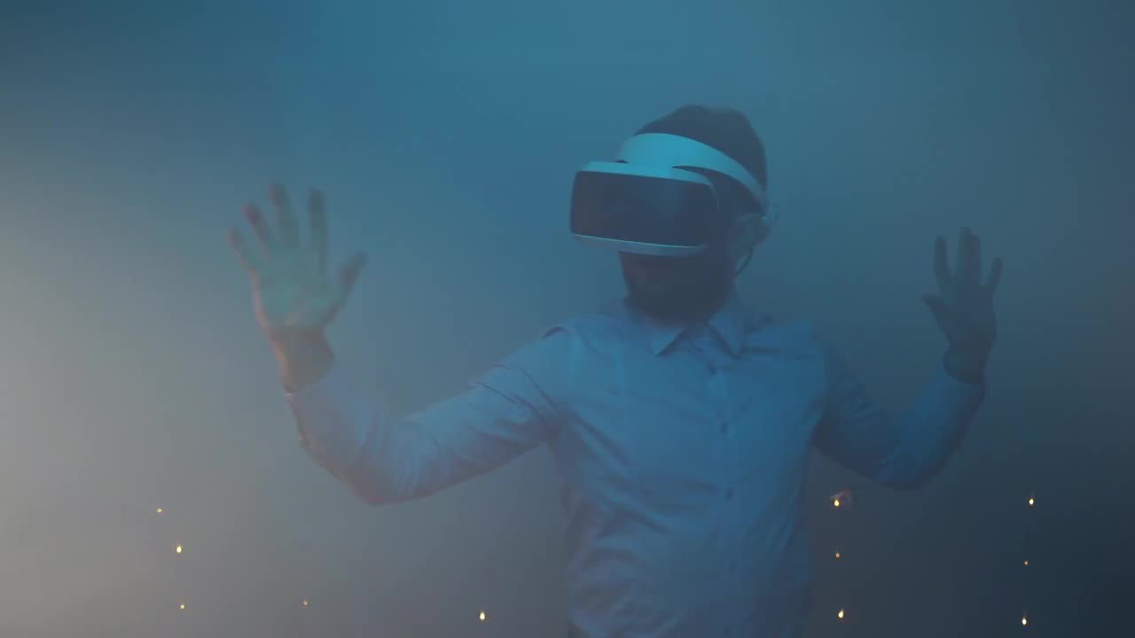
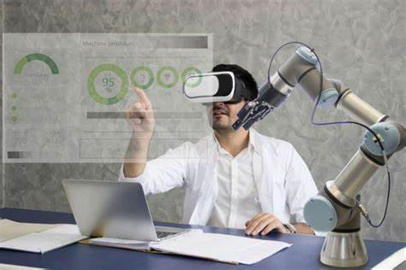
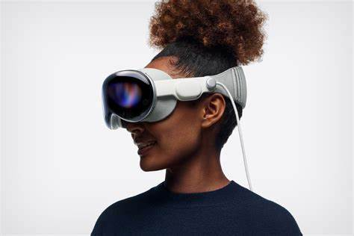
VIRTUAL REALITY
Introduction
What?
immersive experience
to end-users via a “life-like” CG environment.
Why?
Entertainment, Education, Medicine…
Why Now?
Technological Innovation
Market Growth ( 80B$ in 7 years)
Notes:
A lot of interest: apple vision pro, Meta rebranding, and money

Slide 5
SOFTWARE TESTING OF VIRTUAL REALITY
Introduction
Why?
Provide High-Quality Software and experiences
Why not?
Complex structure, lack of tool support
Notes:
Especially important: dizziness, motion sickness, vomiting, hard to convince users to give a second chance
Complex structure, similar to games infinite automate issue, lack of tool support
Existing research : VR code smell, code deps, perf. Optimization
Emphasize lack of testing

Slide 6
Research Questions
Introduction
01
To what extent are test cases developed for VR applications?
02
How effective are the test cases developed in VR applications?
03
What is the design quality of test cases developed for VR
applications?
04
What are the different categories of VR Test Cases and
which categories require specific VR-attention?

Slide 7
Introduction

Slide 8
Background

Slide 9
VIRTUAL REALITY CONCEPTS
Background
Physics System
Animation System
Ensures that objects respond correctly to different physical forces ( collision, gravity,…)
Animate objects via movements and actions such as jumping, stopping, rotating, etc.
Graphics System
Other concepts:
Controls the appearance of objects: Rendering, Display, Lighting, etc.
GameObject: fundamental class of all objects
Colliders: invisible physical shapes of systems used by Physics engine.
Notes:
Simulates physical forces

Slide 10
Background

Slide 11
Research Approach

Slide 12
Dataset
Initial Dataset
100 Manually-verified Unity-based VR projects, collected by Nusrat Et al. [1]
Expansion
GitHub-based search using keywords such as VR, Virtual Reality, VR Unity etc.,
application of filtering criteria proposed by Nusrat et al., and manual validation.
Final Dataset
314 projects: 164 Independent, 67 Organizational, 83 are academic.
[1] “How Developers Optimize Virtual Reality Applications: A Study of Optimization Commits in Open Source Unity Projects.”
Notes:
Three Of which were not found,
100 commits minimum
Indie: 1 contributor, academic: assignments, projects, research ( students), org.: owned by orgs on Github ( MS, Vive)
Add form of reference.
Go quicker.

Slide 13
Overall Approach
314 projects
61 projects
with tests
RQ1: Test Case Extent
Test to Code Ratio Analysis
VR Unity
Project-set
Automatic test detection
RQ2: Test Case
Effectiveness
Assertion Density Analysis
RQ3: Test Case
Design Quality
Test Smell Detection
370
Test Cases
RQ4: Test Case
Taxonomy
Randomly-selected Test cases
Test-case Manual Analysis
Notes:
Mention static analysis tools for RQs 1-3

Slide 14
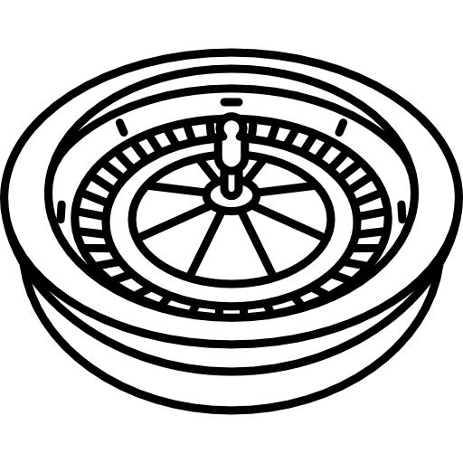
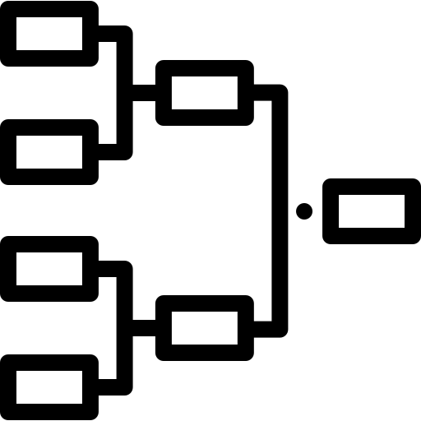
Test Smell Detection
We focused on 6 Test Code Smells
Assertion Roulette (AR)
General Fixture (GF)
Sensitive Equality (SE)
Lazy Test (LT)
Eager Test (ET)
Mystery Guest (MG)
Notes:
AR: and more than one Assert does not provide a message when detecting an issue
GF: fixture initializes fields that are not used by one or more test methods
SE: by comparing based on text representation
LT: tests the same functional method using the same fixture as another test method.
ET: evaluates more than one functional code method with the same fixture
MG: uses external resources that are not managed by a fixture or are not Mock objects.

Slide 15
Test-case Manual Analysis
370
Test Cases
Planning
Identification
& Extraction
Construction
Validation
95% confidence
out of 8723
Performed by 4th Author
Area: VR-Testing
Goal: Aspects of VR
Projects under Validation
Structure: Tree
Approach: Qualitative
2 Authors prepared detailed report about tests.
3rd Author joined categorization.
Differences resolved via voting over multiple rounds
Card Sorting Process
Grouping similar characteristics into Main and sub-categories
Notes:
To minimize bis

Slide 16
Research Approach

Slide 17
Empirical Evaluation

Slide 18
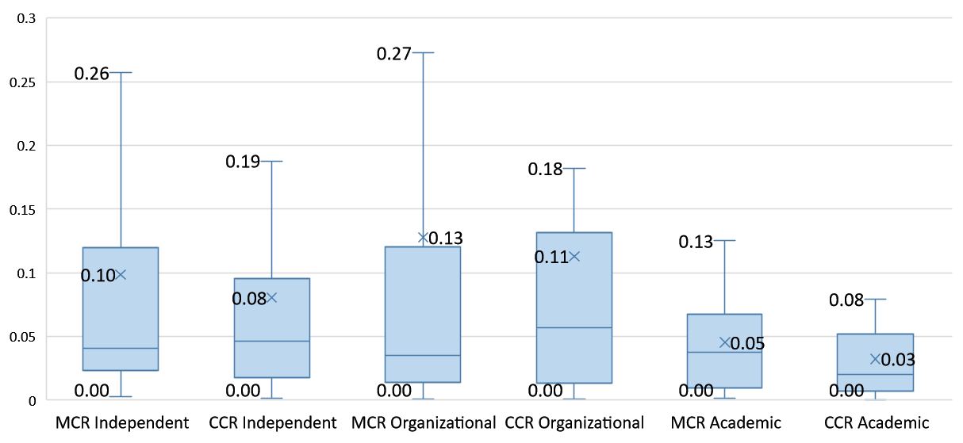
RQ1
Method Count Ratios (MCR)
Class Count Ratio (CCR)
Tests are less common than recommended rates and similar project types
Notes:
C# projects by Microsoft [59], where the LOC ratios were between 0.35 and 0.89.
Keep only some numbers.
Add findings below

Slide 19
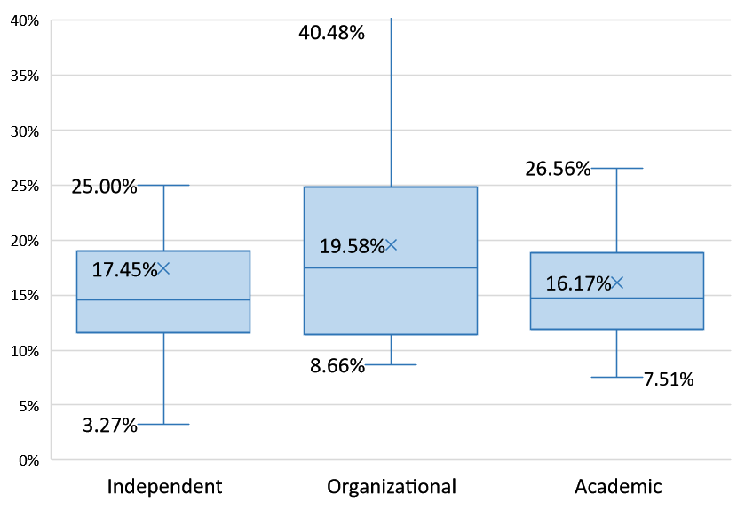
RQ2
Assertion Density
Assertion Density values are linked with less effective testing practices
Notes:
These values are even lower than those found within mobile applications [44], and they are linked with less effective testing practices
Keep only some numbers.
Add findings below

Slide 20
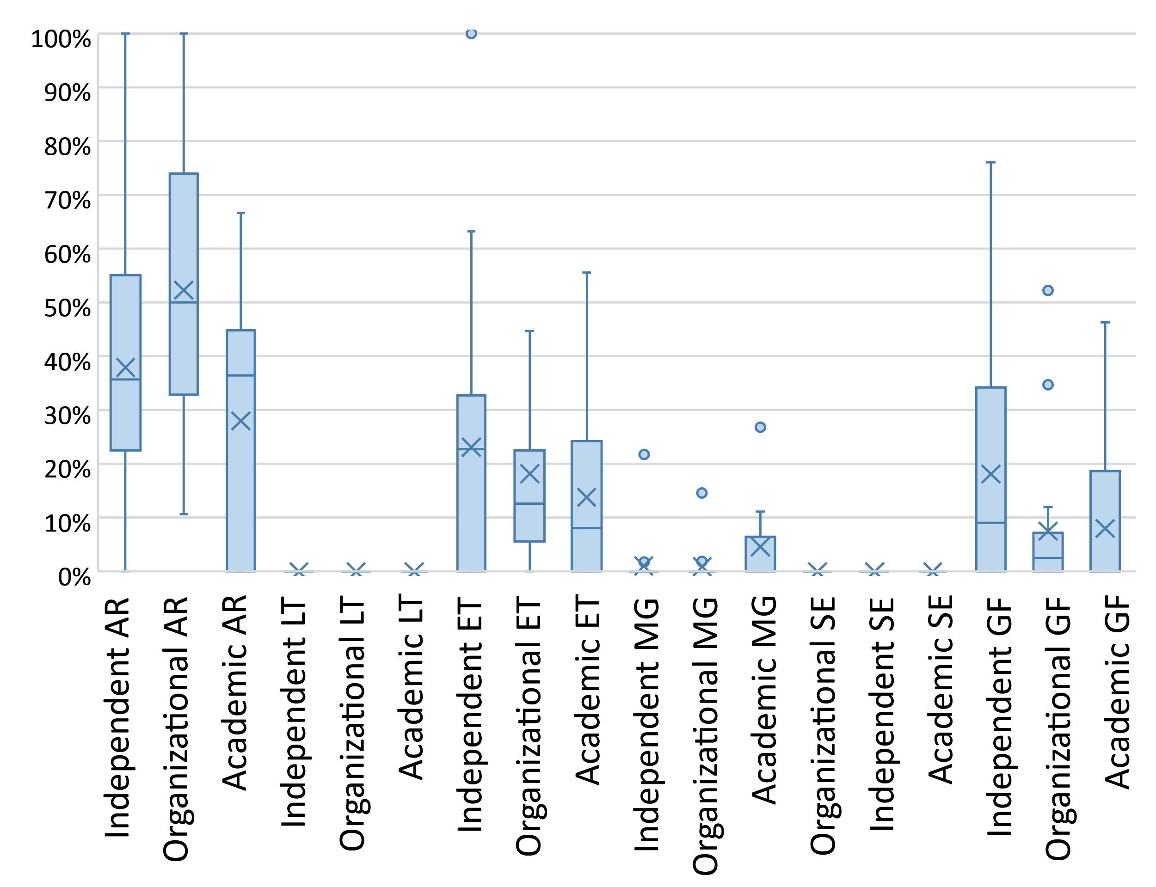
RQ3
Test smells are common across different project categories
Notes:
AR: difficult to diagnose failures cause of method
ET: difficult to diagnose which method fails
MG: tests fail in other env. Or if res. Is unavailable
GF: memory consumption, evolving more difficult
No LT and SE: not enough tests for LT, SE is rare because comp is on specific props.
Add findings below

Slide 21
RQ4
VR Test Case (48,292,30,370)
Category
(No. Tests Independent, No. Tests Organization, No. Tests Academic, Total)
Data Test (1,11,1,13)
A/V Test
(1,6,0,7)
Physics Test(9,14,3,26)
GUI Test(0,8,0,8)
Animation Test(3,1,0,4)
Network Test(1,5,0,6)
Graphics Test(5,4,1,10)
Asset Test(5,3,0,8)
Input Test (0,35,0,35)
Device Test(0,36,1,37)
App Logic Test(21,193,22,236)
Performance Test(3,2,0,5)
Layout & Control Test(0,31,0,31)
Interaction Test (0,4,0,4)
Rigid Body & Character Test(2,3,0,5)
Collision Test (3,3,0,6)
Colliding Test(4,7,3,14)
Rendering Test (4,3,1,8)
Camera Test(1,1,0,2)
Game Obj Prop
Test(6,20,1,27)
Event Test(0,54,0,54)
Authentication Test(0,0,3,3)
Exception Test(1,4,0,5)
Configuration Test(1,4,0,5)
Others(19,114,19,152)
I/O Test(0,13,0,13)
Location Test0,4,0,4)
Notes:
Rigidbody enables control of objects through the Unity physics engine
involve dataset evaluation through caching systems, local file systems, or other local and remote databases
assess the compatibility and functionality of VR hardware and software.
We define a Vrattention test as a test that involves VR devices and VR experience, which are less likely to appear in non-VR applications.
GUI Test, were observed VR-attention test cases that focus on the VR experience. For example, one test method creates a sequence
of hand movements to simulate actions like touch, and scrolling and evaluate the correctness of designated GUI effects.
Input Test, the observed VR-attention test cases focus on both VR experience and VR devices. For example, one test method in Layout
and Control Test focuses on validating the control layout load from the XR devices of certain manufacturers, and another test method
in Interaction Test focuses on validating how eye-tracking system could capture the target object with other disturbing objects.
In Performance Tests, the observed VR-attention test cases focus on the scalability of the VR experience. The tested app is a VR sketcher,
which allows users to draw 3D lines and shapes. Users can freely twist and drag 3D lines by adding control points. The performance
test evaluates the app’s ability to handle a large number of control points. In Device Tests, the observed VR-attention test cases
mainly focus on VR devices. For example, one test method validates whether a VR hardware device can be automatically configured by
pre-defined identities.
Add findings below ( there’s similarity but also some specific cats.)

Slide 22
Results

Slide 23
Implications

Slide 24
Implications
For VR Developers
Tests needs to become a bigger focus, and general guidelines are provided
For VR Tool Builders
Tool support for code coverage and automatic test smell detection needs to be improved

Slide 25
Implications
For SE Researchers
VR Testing adoption barriers, how to overcome them, VR-specific test-smells, automatic test-case generation for VR projects.

Slide 26
Implications

Slide 27
Conclusion

Slide 28
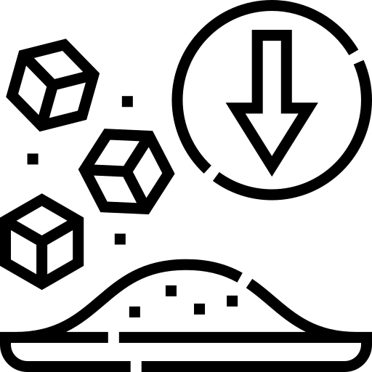
Conclusion
We performed the First qualitative and quantitative analysis on VR-Testing, and built test effectiveness analysis and test-smell identification tools
for Unity-based projects
We found that VR testing is less widespread, less effective, and has lower design quality
Our findings on testing
practices in VR applications will allow future researchers to determine
VR testing challenges and inspire future research on VR test
automation.
We built a VR-Test taxonomy which reflect the characteristics
and specificities of VR applications, along with the identification of
VR-attention test categories

Slide 29
Thank you for your attention!
Any Questions?
Corresponding Author :
Dhia Elhaq Rzig
dhiarzig@umich.edu
https://Dhiarzig.netlify.app

Slide 30
SOFTWARE TESTING
Introduction
What?
examining the artifacts and behavior of software via validation and verification.
Why?
Evaluate the software, find its flaws
Notes:
Testing is in the name of the conference, so I would assume you’re all familiar

