Slide 1
Characterizing the usage of CI
Tools in ML software development
Authors:
Dhia Elhaq Rzig, University of Michigan - Dearborn
Foyzul Hassan, University of Michigan - Dearborn
Chetan Bansal, Microsoft Research
Nachiappan Nagappan, Microsoft Research*
* Nachiappan Nagappan was with Microsoft Research when this work was done. He is now with Meta Platforms
Notes:
Ph.D candidate, starting my 3rd Year at UM Dearborn,
done in collaboration with my supervisor,
2 from MSR, Nagappan is now with Meta

Slide 2
Outline
Introduction
Background
Research Methodology
Results
Implications
Conclusion
2

Slide 3
Introduction
3

Slide 4
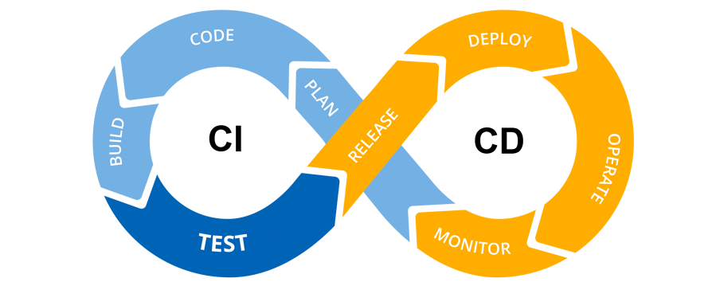
Introduction
03
Continuous
Integration:
What?
Automatic integration of code changes within shared repositories
Why?
Quicker bug catching
Quicker PR integration
More frequent releases
4
Notes:
-. In simpler terms, with each git commit (or other trigger), the CI server attempts to run the CI script, which can be configured for building, testing, etc.
- according to a recent Github study, CI projects average 0.54 releases per month, while non ci average 0.24 releases. Median pull is accepted 1.6 times faster.

Slide 5
Introduction
Machine
Learning:
What?
Incremental and automatic solution
finding
Why?
Solves complex problems which have inefficient or non-existing explicit solution
5
Notes:
ML apps: instead of being given an explicit solution like traditional software, they form their solutions by analyzing data, testing their findings, evaluating their results, and iterating on these phases.

Slide 6
Introduction
What ML software needs, CI provides..
But both have their Problems:
Development processes and practices are different from those of traditional software
ML software, like traditional software, relies on iteration and repetition of processes
ML and CI :
Match made in Paradise?
CI is built for iterative and repetitive processes, and is perfect for meeting these needs
Much more difficult to debug then manual and local execution of processes, Infrastructure problems…
6

Slide 7
Introduction
Research Questions:
What is the adoption rate of CI among ML projects?
2. What tasks does CI perform for ML projects?
3. How often and Why do CI builds break in ML projects?
7

Slide 8
Introduction

Slide 9
Background

Slide 10
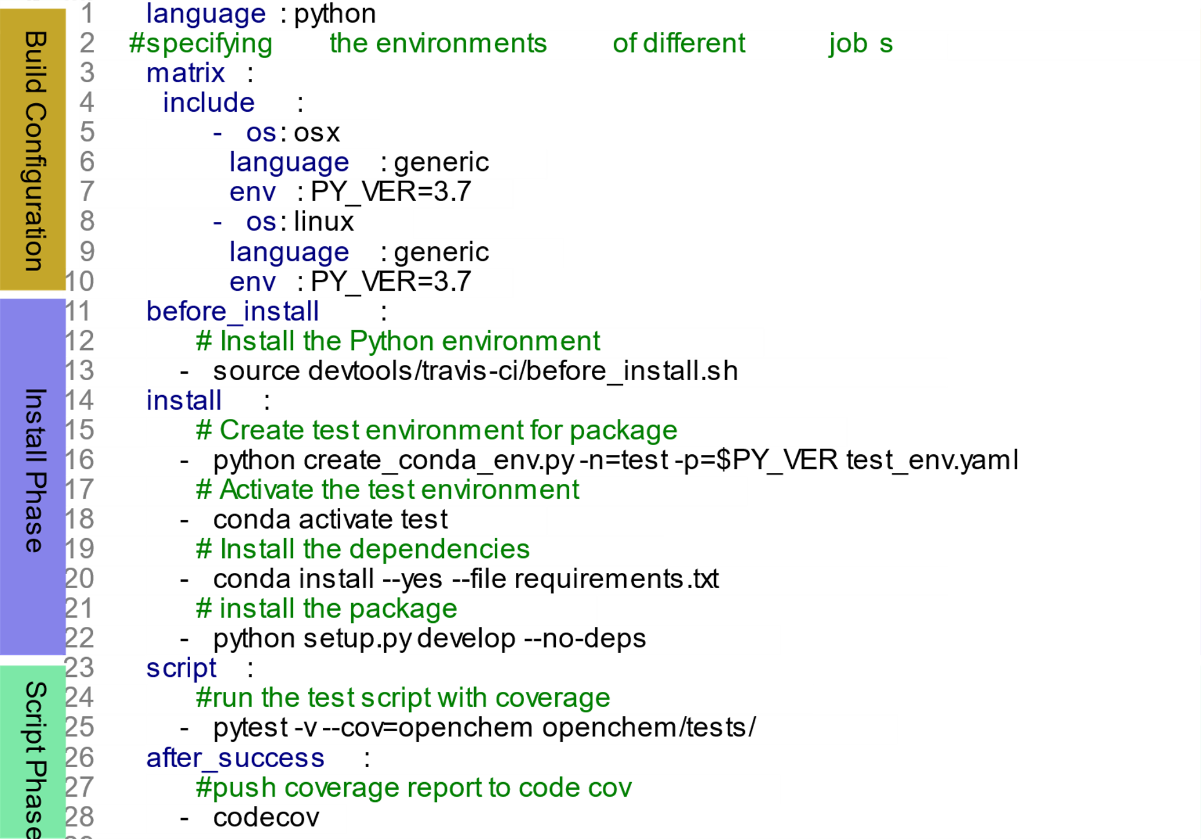
Background
Travis:
The most popular CI tool for all open-source projects, and for open-source ML projects as well.
Configured via .travis.yml file, in the root of the repository
Has a powerful but complex lifecycle
Job starts
Script
Script
Job failure
Install
After success
After failure
Before install
Job error
Deploy
Install
Job ends
Before Deploy
Before Script
Deploy
After Deploy
After script
Job ends
10
Notes:
CI is a success story, grew from 40% to 68%
variety of CI tools and services, but
Travis CI workflow is described via a .travis.yml file, written in YAML-based [24] Domain Specific Langauge (DSL), an example of which is illustrated. A workflow execution is generally referred to as a build and can be composed of one or more stages that run sequentially, marked by the keyword.
default: build is composed of only one stage.
Each stage may be composed of one or more Jobs that run in parallel, each executing the same sub-script in a specific environment different from the other jobs.
A generic job state machine is illustrated. A job has two phases, the install phase, meant for the installation of any dependencies and preparation of the environment, a job that experiences an issue during this phase it immediately stops executing, referred to as errored.
A script phase, which runs the build, test, and any other tasks specified by the developer, such as build, test, etc. if it experiences failure. it executes its "after failure“ section, and the rest of its script phase.
A notable exception is that if a job experiences an issue only during its Deploy or After Script phase, it’s still labeled as passed. A build/ job can be canceled by the developer.

Slide 11
Background

Slide 12
Research Methodology

Slide 13
Dataset
Initial dataset: The State of the ML-universe: 10 Years of Artificial Intelligence &
Machine Learning Software Development on GitHub, Gonzalez et al.
After Manual curation to solve problems with dataset, we obtained:
4031 ML projects
4076 Non-ML projects
Referred to as Breadth Corpus
Which we used for CI adoption Analysis
Filtering for Python-Based Travis CI-using projects, we found:
476 ML Projects
202 Non-ML Projects
Referred to as Depth Corpus
Used for the remainder of the analysis
13
Notes:
Breadth Corpus. Our goal was to analyze CI adoption within a set of open-source and active Machine Learning (ML) software
projects. . we chose to analyze the data-set of ML projects proposed by Gonzalez et al. [36]. Which has 5224 ML project and 4101 NonML projects.
Issues with quality of ML set, manual filtration
Depth Corpus. After estimating the adoption rates of different CI tools, we found that Travis CI was the most popular CI tool for ML projects,, same as OSS in general. Furthermore, for the ML projects that used Travis CI, Python is the
main language for 51.06%of them, as reported by the GitHub API [16], and no other language was the main language for more than 9% of them. This aligns with results found by Gonzalez et al. [36] concerning Python being the most popular language for ML projects.
As a result, we select Python-based ML projects for our depth, and a comparative set of Non-ML Python projects.

Slide 14
Overall Approach
4031 ML
4076 Non-ML Projects
Travis Server
5130 ML
4076 Non-ML
Projects
File System Analysis
API Analysis
GitHub Server
RQ1: CI Adoption
Manual Curation and Classification
AST
Analysis
476 ML
202 Non-ML
Travis-using
Python projects
RQ2: CI Goals
RQ3: CI Problems
Log
Analysis
14
Notes:
For RQ3. , API analysis for frequency, Log Analysis for taxonomy

Slide 15
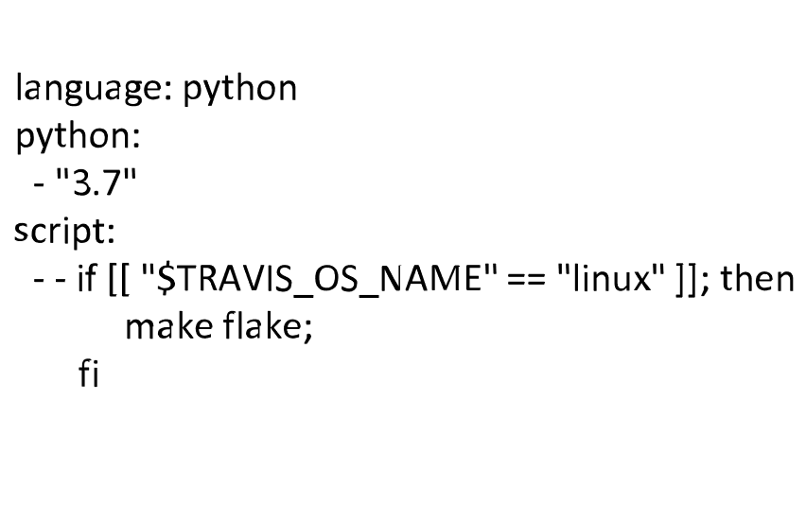
CI Task Analysis
Travis.yml configuration, based on YAML, but also integrates shell commands
To Deal with Heterogenous script, we built a new AST analyzer, TravAnalyzer
.
t
r
a
v
i
s
.
y
m
l
l
a
n
g
u
a
g
e
s
c
r
i
p
p
t
y
t
h
o
n
p
y
t
h
o
n
3
.
7
i
f
[
[
"
$
T
R
A
V
I
S
_
O
S
_
N
A
M
E
"
=
=
"
l
i
n
u
x
"
]
]
;
t
h
e
n
m
a
k
e
f
l
a
k
e
;
f
i
15
Notes:
- CI configuration files (e.g., .travis.yml) define continuous integration tasks such as build, test, deploy, etc. Travis = YAML.
- However, analyzing the Travis CI configuration file is not trivial as it can invoke system commands, external shell scripts, Python scripts, etc.
- This heterogeneity of functionality and syntax makes CI task analysis very complex. To overcome such challenges, we developed the first. TraVanalyzer to parse Travis configuration files from our Depth Corpus projects.
- We extended the Java-based YAML parser DocConverter [12] to extract top-level entities of the configuration file, an example of which is shown.
- We developed a Bash script parser to extract such embedded scripts that can parse and generate AST for them. Since Bash script supports variable assignment and usages, we applied a data-flow analysis [33] on the extracted AST to analyze condition checks.
- However, in many cases, the scripts use system environment variables such as TRAVIS_OS_NAME are used conditions consider these conditions
always true.
- AST uses external tools. we extracted 201 commands , via applied AST clustering based on the command’s name, omitting their parameters. the authors then manually reviewed the tools and commands documentations’ to categorize them into build, test, code analysis, and deployment tools.

Slide 16
CI Task Analysis
Travis.yml configuration, based on YAML, but also integrates shell commands
To Deal with Heterogenous script, we built a new AST analyzer, TravAnalyzer
.
t
r
a
v
i
s
.
y
m
l
l
a
n
g
u
a
g
e
s
c
r
i
p
p
t
y
t
h
o
n
p
y
t
h
o
n
3
.
7
I
f
S
t
a
t
e
m
e
n
t
then
C
test
o
n
d
i
t
i
o
n
(
=
=
)
C
o
m
m
a
n
d
P
a
r
a
m
:
f
l
a
k
C
e
m
d
:
m
a
k
l
e
i
n
u
$
x
T
R
A
V
I
S
_
O
S
_
N
A
M
E
To Deal with External commands and tools, we applied AST clustering.
16
Notes:
CI configuration files (e.g., .travis.yml) define continuous integration tasks such as build, test, deploy, etc. Travis = YAML.
However, analyzing the Travis CI configuration file is not trivial as it can invoke system commands, external shell scripts, Python scripts, etc.
- This heterogeneity of functionality and syntax makes CI task analysis very complex. To overcome such challenges, we developed the first. TraVanalyzer to parse Travis configuration files from our Depth Corpus projects.
Result 1 using existing DocParser
We developed a Bash script parser to extract such embedded scripts that can parse and generate AST for them
- AST uses external tools. we extracted 201 commands , via applied AST clustering based on the command’s name, omitting their parameters. the authors then manually reviewed the tools and commands documentations’ to categorize them into build, test, code analysis, and deployment tools.

Slide 17
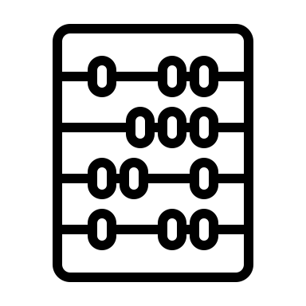
CI Failure Analysis
Manual Analysis and
Labeling
Key words and patterns for
different types of failures
Randomly Select 100
Failure Logs
Saturation < 90%
Saturation >= 90%
CI Failure
Taxonomy
Card Sorting
Method
Different Failure
Categories and their
stats
Saturation
17
Notes:
We used Travis API to find info about the amount of passed, failed, etc. builds of projects
To classify the failure, we tried to use existing taxonomies , problems concerning adequacy and granularity
we manually analyzed them to extract regular expressions belonging to different failure types, each of which is associated with one CI task.
Saturation rate is defined as rate of finding at least one failure type within job failure logs
2 authors followed the card sorting method of grouping similar failures and errors as identified by the regexes into multiple main and subgroups.
This hierarchy was simplified by merging most similar sub-groups leaving only the ML-specific failure types at the 3rd level of the taxonomy tree, to help increase the ease of understanding and generalization of this taxonomy, after which 6 main and 18 subgroups remained.
- We constructed the error taxonomy using the same method, but we chose to only leave 4 main categories as they contained less internal variability within them in comparison to those of the failure taxonomy.

Slide 18
Research Methodology

Slide 19
Results

Slide 20
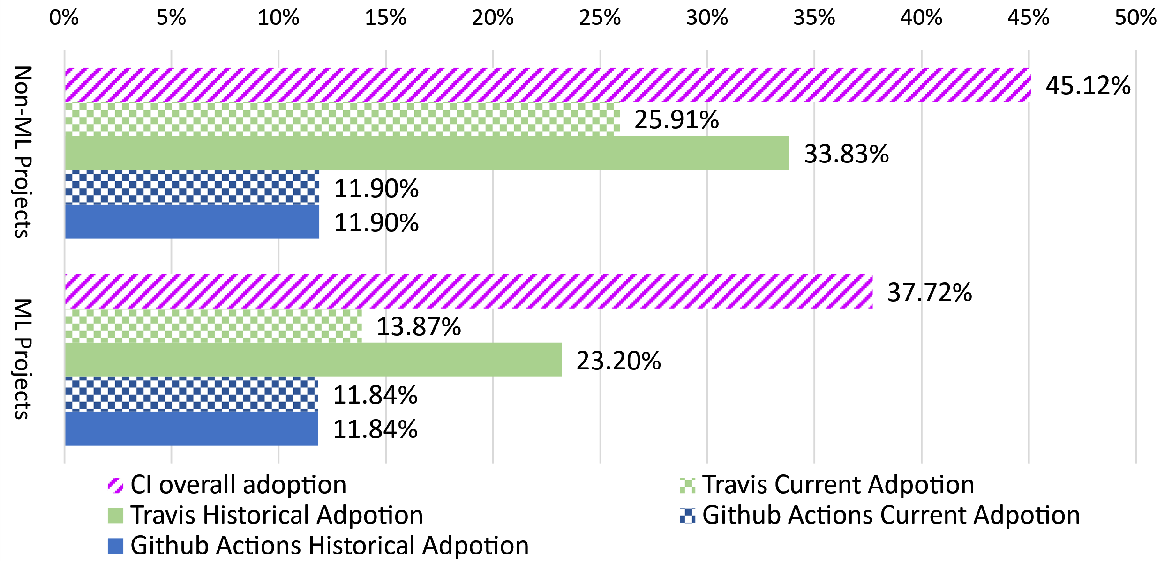
RQ1
Historical: Project has Builds on CI server
Current: Project has Builds on CI server and File of CI tool
20
Notes:
- surprising GitHub Actions, as support for CI was only added to it in public beta in August 2019
- Overall the adoption of CI by ML projects is between 24.46%, and 37.22%,, which trail behind those of our comparison set of Non-ML projects, estimated between 38.84%, and 45.12%.
And OSS in general which is estimated at 40.27%,by Hilton et al.

Slide 21
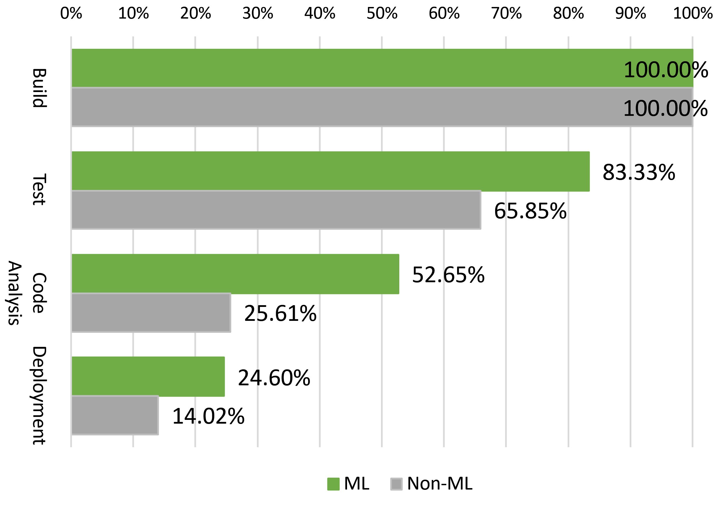
RQ2
Build: Pip, conda
Test: pytest, nosetests
Code Analysis: Coverage,Pylint
Deployment: Docker, PyPI
21
Notes:
The build category includes both build environment preparation and build configuration and execution commands.
For code analysis, which includes static analysis, linting, and code coverage tools.
- In addition, along with the higher adoption of the different functions of CI by ML projects, there is a higher diversity of tools being used by these projects to achieve those goals in comparison to Non-ML projects.

Slide 22
RQ3
Job Failed
35977
7153
Code Analysis Error
Shell script failed
Test Errored
7024
149
5112
2219
15482
1295
17.9%
2.1%
13.0%
31.1%
39.4%
18.1%
Travis Failure
Coverage Requirement Unmet
Linting Requirement Unmet
Other Command Failure
Dependency Install Problem
Test Environment Problem
Error during Test Collection
Test Failed
6722
1426
60
0
1189
0
1420
719
1376
364
1382
801
6389
222
17.1%
20.0%
0.9%
0%
16.9%
0%
27.8%
32.4%
26.9%
16.4%
8.9%
61.8%
41.2%
17.1%
18961
3761
Security Error
Out Of Memory Error
General CA Exception
Resource Not Found
48.3%
52.7%
Deployment Error
Test Fixture Error
ML Module Not Found
Failed due to Assertion Exception
Failed due to Other Exception
994
49
211
0
5775
149
6
0
2316
1136
7322
272
1426
0
14.8%
3.44%
3.2%
0%
100%
0.01%
0%
45.3%
51.2%
82.2%
14136
3490
47.3%
21.0%
19.5%
0%
4817
271
Time Out
Incomplete log
25.4%
7.2%
74.6%
92.8%
Failure Subtype
CUDA problem
ML-Specific Assertion
94
0
4276
1366
1.4%
0%
63.7%
95.8%
#ML Jobs
#Non-ML Jobs
144
0
1060
0
2.0%
0%
Percentage
Percentage
22
26.4%
0%
Legend
Notes:
Comparing Frequency of failures and errors, we found similarities between Non and ML, let’s focus on the types of failure.
Script Failure: This failure is the result of an error during the execution of the shell script or the python script as it attempts to execute tasks related to preparing the environment for CI processes and execute each one of them
Test Failure: One or more tests ran correctly, but identified problems within the functional code being tested. The functional code needs to be modified to resolve this problem; ML-specific Assertion, which indicates that an exception specific to the context of ML projects has occurred, such as the following example where the model prediction result does not meet the accuracy threshold
Test Error: One or more tests did not run correctly, due to problems within the test build up or tear down, or other processes related to preparing the environment to execute a test ; Error During Test Collection: This indicates an error occurred while the testing framework was attempting to collect the tests across the different test-script files. For example missing modules or indentation errors within the test file
Test Fixture error: An error that occurs during the execution of a pre-test or a post-test method, also known as fixtures, due to a programmatic problem during the execution of these methods such as a resource not being found . An ML-specific sub-type of this exception is the CUDA Problems, which indicates an exception related to the CUDA ML framework, and the other one is ML Module Not found, which specifies that the test fixture was unable to import a module generally associated with ML projects such as Tensorflow
Other Code Coverage: is occurs when an exception is thrown during a code analysis process. In general, it’s due to an unexpected exception during the process of Code Coverage or Linting.

Slide 23
Results

Slide 24
Implications

Slide 25
Implications
For Researchers:
1. CI is adopted by up to 37.22% of ML projects, showcasing its importance as a subject of study.
2. Travis CI is the best source of information regarding CI practices of ML projects, TraVanalyzer is useful to analyze them and can easily be extended to other types of Travis-using projects.
3. Our Failure taxonomy and corresponding log analyzer can help with the automatic detection and debugging of the more frequent ML CI problems .
25
Notes:
For Researchers.
First, while CI in ML projects has not received much attention from the research community, it’s adopted by up to 37.22% of ML projects, showcasing its importance as a subject of study. We provide researchers with a set of CI-using ML projects [26 ], in order to guide their work in developing and adjusting CI servers and tools for ML projects.
Second, Travis CI is the best source of information regarding CI practices of ML projects, and based on our study, there is no evidence of the widespread adop- tion of CI platforms specifically designed for ML projects. Thus, TraVanalyzer [ 26 ] is a great tool to further investigate CI prac- tices in ML projects and can be easily extended to support other types of Travis-using projects, especially since we were able to successfully use it in our set of Non-ML projects.
Third, we found some of the most frequent CI problems of ML projects were related to test failures, test errors, and code analysis failures. Our Failure taxonomy and corresponding log analyzer can help with the au- tomatic detection and debugging of these problems and guide the development of Travis CI configuration repair tools

Slide 26
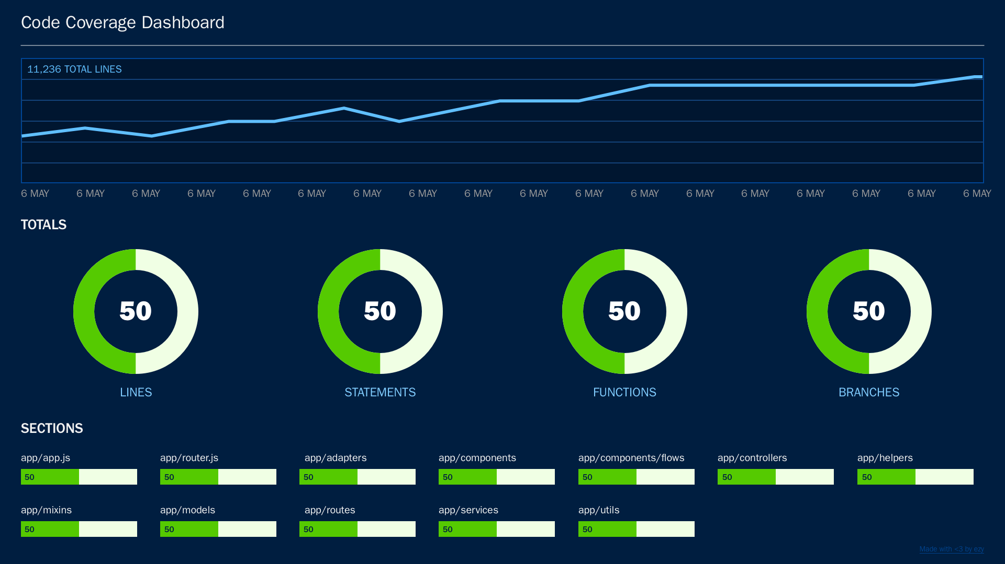
Implications
For ML Developers:
Using CI tool for building is not enough. Testing, and code analysis, especially code coverage, are highly recommended, and should adopted alongside CI. They should be adapted to the context of the project and ML.
26
Notes:
For ML De-velopers. While adopting a CI tool is a step in the right direction, using it for building is not Testing, and code analysis, especially code coverage, are highly recommended, and should adopted alongside CI. They should be adapted to the context of the project and ML.
For example, during our manual log-analysis step for the construction of our CI Log analyzer, we found that some projects are executing their tests on the same test set in every build, increasing their risk of ML model over-fitting. To avoid this problem, ML projects are recommended to vary their test sets frequently [40 ].
Another example is that some ML projects had jobfailures due to a restrictive 100% code coverage requirement, whichcan be harder to achieve as the code-base grows. Relaxing this requirement or monitoring CI status frequently can help minimize unnecessary disruptions.

Slide 27
Implications

Slide 28
Conclusion

Slide 29
Conclusion
We found that CI has been less widely adopted among ML projects in comparison to Non-ML projects
We analyzed the different tasks that these two project categories execute with CI.
We extracted knowledge about common problems of CI in ML projects, we have also contextualized these results by comparing them with similar Non-ML projects.
We plan to utilize the tools we developed to build an open-source tool-chain for automatic fault localization and repair of CI build breakages in ML projects.
29

Slide 30
Thank you for your attention!
Any Questions?
Corresponding Author :
Dhia Elhaq Rzig
dhiarzig@umich.edu

Slide 31
Background
The Rise of CI:
It arose from the resource-intensive task of code integration, by relying on frequent synchronization of distributed software repositories, and automating the execution of building, testing and other processes.
A success story: adoption grew from 40.27%
in 2016 to an estimate 68% in 2018
31

Slide 32
RQ3
32
Notes:
the percentages of the different types of build-outcomes per project within our Depth Corpus of projects
While ML projects seem to have a higher average rate of passing builds in comparison to Non-ML projects, it’s important to also note the higher internal variability in terms of build-outcomes shown by the Non-ML projects.
- The results for Non-ML comparison set are surprising, especially when comparing our findings to Beller et al.’s findings regarding open-source software, where they found that an average of 82.4% of the builds for Java projects and an average of 72.7% of the builds for Ruby projects are passed, but it’s important to note that our comparison set is composed of Python-based projects.

Slide 33
CI Adoption
File System Analysis
33
Notes:
Currently, there is no standardized approach to determine whether a GitHub repository is using a CI tool. In order to determine the adoption of different CI, tools within our set of ML projects, we developed a two-pronged approach to estimate the adoption rates of the different continuous integration tools, based on methods followed by Hilton et al. [39] and Gallaba & Mcintosh. [35].

Slide 34
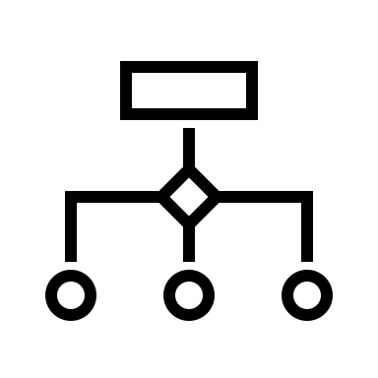
CI Adoption
Project
CI Tools
filename
patterns
Project Files
Matching
List of CI Tools
In-use
34
Notes:
Then we attempted to match their names with the naming conventions of configuration files of different CI tools.
To build our list , we started with that of Leite aet al. included only four tools and was developed by examining traditional software projects.
2 co-authors manually analyzed the names of non-source code files with naming conventions of different CI tools, 11 CI tools in total.
Second, we scanned the project repositories 1 to determine if they had files indicative of the usage of a specific CI tool.

Slide 35
CI Adoption
API Analysis
35

Slide 36
CI Adoption
Travis Server
GitHub Server
GitHub Actions
Builds of
projects
Project Info.
Travis Builds
of projects
Project Info.
Communication with Travis
Communication with
GitHub
Project
36
Notes:
We applied the principle of triangulation [28] to further validate our results. We queried the APIs of the two most popular CI tools as determined by our first approach and used the criteria of the existence of one or more build to establish a project’s adoption of a specific CI tool.
To resolve conflict
Historical Adoption: A project that has builds on a specific CI tool’s server, but does not have the CI tool’s configuration files in its current repository, is assumed to have used the CI tool in the past. Current Adoption: A project that has builds on a specific CI tool’s server and has the tool’s configuration file(s) within its current repository, is assumed to be currently using the CI tool.

Slide 37
Build: Python, C++, Java
Stage 1
Linux
Mac OS
Install
Install
Script
Script
Stage 2
Linux
Mac OS
Install
Install
Script
Script

