Slide 1




An Empirical Study on ML DevOps Adoption
Trends, Efforts, and Benefits Analysis
Authors:
Dhia Elhaq Rzig, University of Michigan - Dearborn
Foyzul Hassan, University of Michigan - Dearborn
Marouane Kessentini, Oakland University
Notes:
Ph.D candidate, starting my 4th Year at UM Dearborn,
done in collaboration with Oakland University

Slide 2
Outline
Introduction
Research Methodology
Results
Conclusion
2

Slide 3
Introduction
3

Slide 4

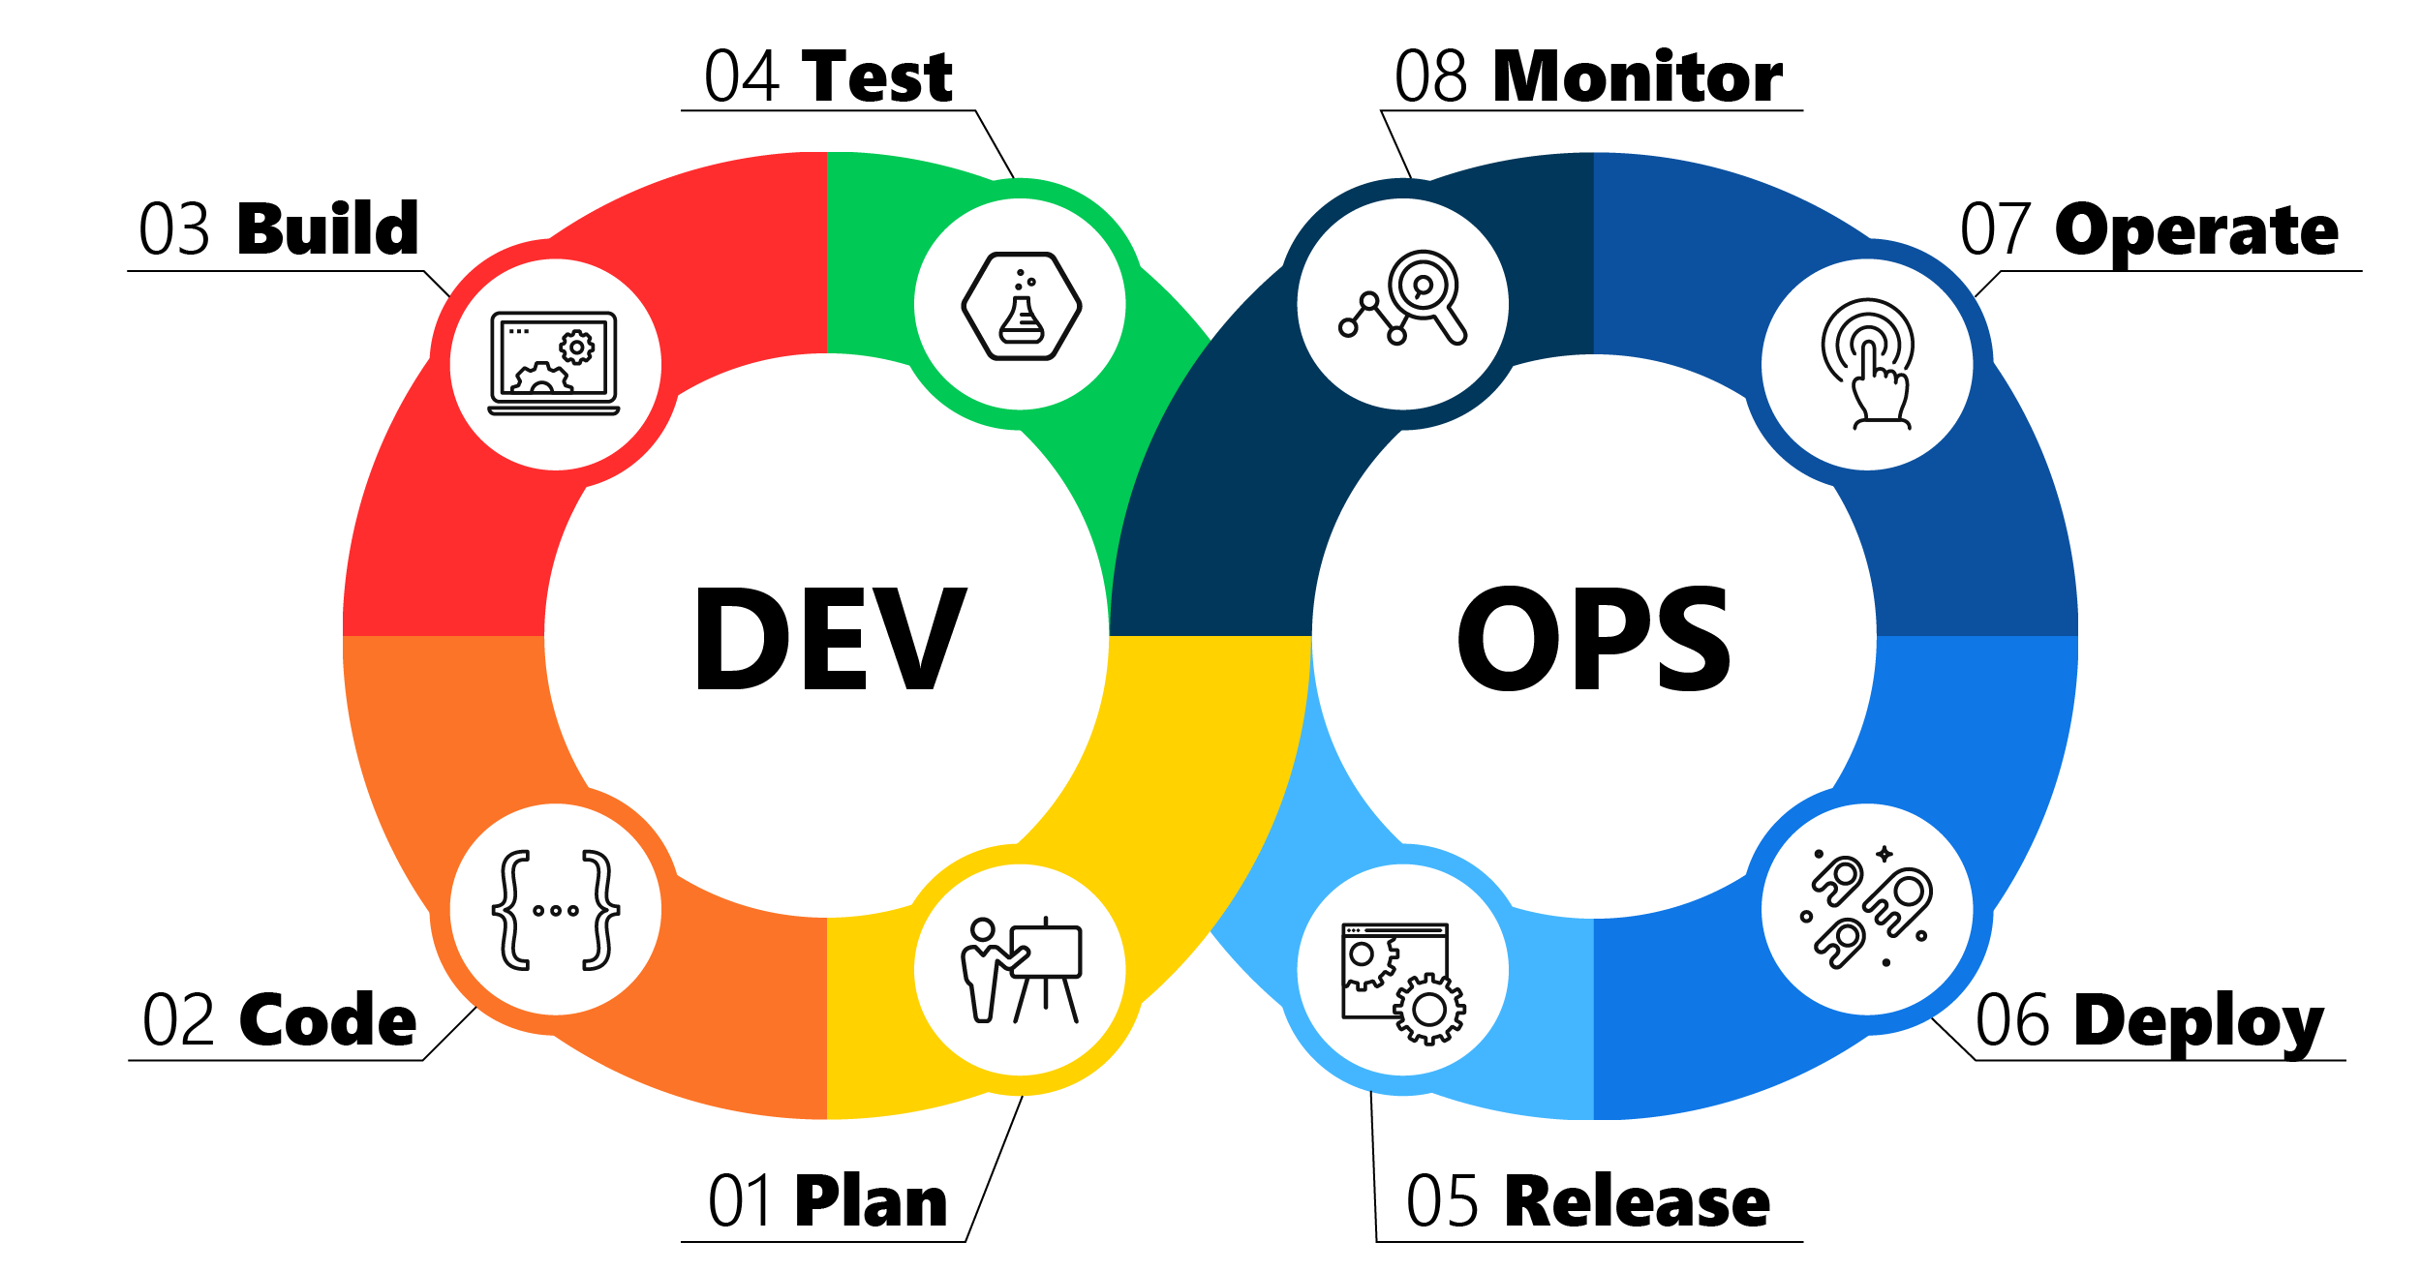
Introduction
03
DevOps
What?
Automation of production processes such as build, test, code analysis…
Why?
Faster down time recovery
More frequent deployment
Lower failure rate
4
Notes:
DevOps is a modern software engineering paradigm that brings changes to production processes with the approach of automating the building, testing, code analysis and deployment of software.
recent GitHub study [7] discovered that DevOps teams recover from downtime 96 times faster, have a 5 times lower failure rate, and a 46 times more frequent deployment rate.

Slide 5

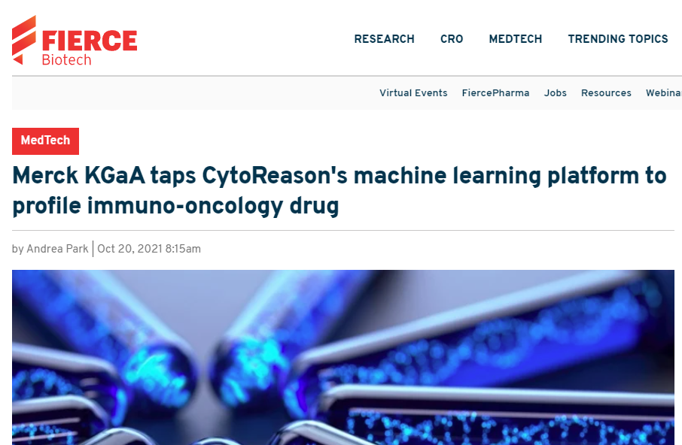

Introduction
Machine
Learning:
What?
Incremental and automatic solution
finding
Why?
Solves complex problems which have inefficient or non-existing explicit solution
5
Notes:
Short description, don’t detail tools.

Slide 6

Introduction
The state of DevOps in ML projects:
Mostly in the dark
DevOps Tools/ Works for ML projects
But are ML projects using DevOps?
MLFlow, Amazon SageMaker, Spack, Easy Build, Docker, Kubernetes, Ease.ml
Are ML projects struggling with or benefiting from DevOps?
Their maturity and quality of ML-support varies, and they are tool or framework specific
6
Notes:
Short description, don’t detail tools.

Slide 7
Introduction
Research Questions:
What are the current and historical adoption rates of DevOps Tools for ML and Non-ML projects?
2. What are the maintenance efforts and goals associated with DevOps tools across the different project categories ?
3. What are the advantages of adopting DevOps tools across the different project categories?
7

Slide 8
Introduction

Slide 9

Research Methodology

Slide 10


Dataset
Initial dataset: The State of the ML-universe: 10 Years of Artificial Intelligence &
Machine Learning Software Development on GitHub, Gonzalez et al.
After Manual curation to solve problems with dataset, we obtained:
1116 ML Tool projects (E.g.: Tensorflow)
2915 ML Applied projects ( E.g.: Faceswap)
4076 Non-ML projects
We used the GitHub API to collect additional information about these projects: Age,
Nb. Stars, etc.
10
Notes:
Breadth Corpus. Our goal was to analyze CI adoption within a set of open-source and active Machine Learning (ML) software
projects. . we chose to analyze the data-set of ML projects proposed by Gonzalez et al. [36]. Which has 5224 ML project and 4101 NonML projects.
Issues with quality of ML set, manual filtration
Depth Corpus. After estimating the adoption rates of different CI tools, we found that Travis CI was the most popular CI tool for ML projects,, same as OSS in general. Furthermore, for the ML projects that used Travis CI, Python is the
main language for 51.06%of them, as reported by the GitHub API [16], and no other language was the main language for more than 9% of them. This aligns with results found by Gonzalez et al. [36] concerning Python being the most popular language for ML projects.
As a result, we select Python-based ML projects for our depth, and a comparative set of Non-ML Python projects.

Slide 11





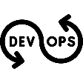




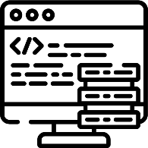




Overall Approach
RQ1: Current DevOps Adoption Rates
potential DevOps
config. files
File Name
Analysis
Performed on 8107
projects
GitHub Linguist Analysis
RQ1 : Historical DevOps Adoption Trends
RQ2: DevOps Adoption
Effort and Change Goals
RQ3: DevOps Adoption Advantages
DevOps Config. File name and path Patterns
DevOps config. files
Performed on Top 1000 ML and Top 1000 Non-ML projects
Cleaned and Cloned Project set
Manual Inspection
Performed on 8107 projects
Build file
Analysis
potential Test files
Test tools
import Patterns
Automatic Test-File Selection
Commit Analysis
Test file
Analysis
Performed on 6855 projects
Phase 1: File, Name and Import pattern collection
RQ3: DevOps Adoption Advantages
Code Quality Analysis
Phase 2: File-System-based analysis
Phase 3: Repository and Commit-based Analysis
11
Notes:
For RQ3. , API analysis for frequency, Log Analysis for taxonomy
Simplify ( highlight the phases)
Add animation for each phase. Clarify the goal / detail

Slide 12

Research Methodology

Slide 13

Results

Slide 14
RQ1:What are the current and
historical adoption rates of DevOps Tools for ML
and Non-ML projects?

Slide 15
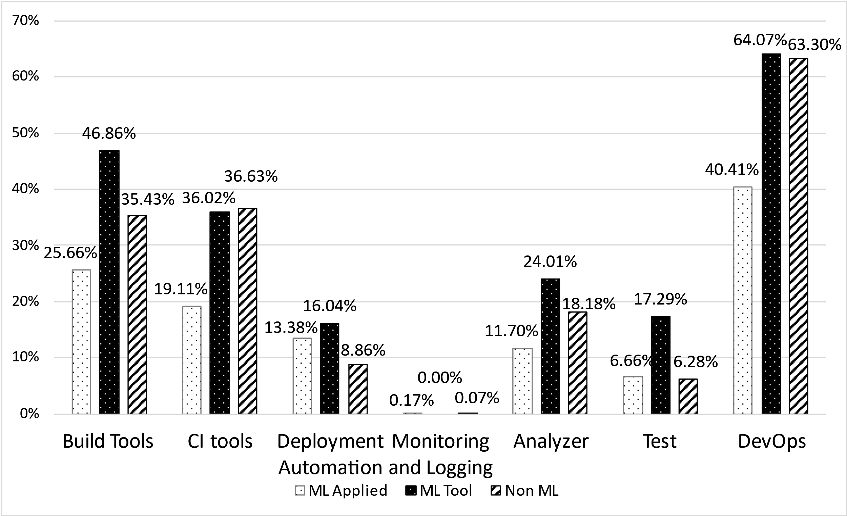
RQ1
Current Adoption
Factors:
ML Applied: Age, Team Size, Nb. Pr. Merged, Nb. Core Pr. Merged
ML Tool : N.b. Stars, N.b. Forks, Nb. Pr. Opened
Non- ML: Age, N.b. Forks, Nb. Pr. Opened
15
Notes:
An ML Applied projects’ DevOps adoption is linked to its age, team size and reliance on PR-based development as measured through its number of pull requests merged
An ML Tool projects’ DevOps adoption is linked to its age, popularity as measured with its number of stars and forks, and its Number of PRs open
A Non-ML projects’ DevOps adoption is linked to its team size, age, popularity as measured with its number of forks and reliance on PR-based development as measured through its number of pull requests open

Slide 16
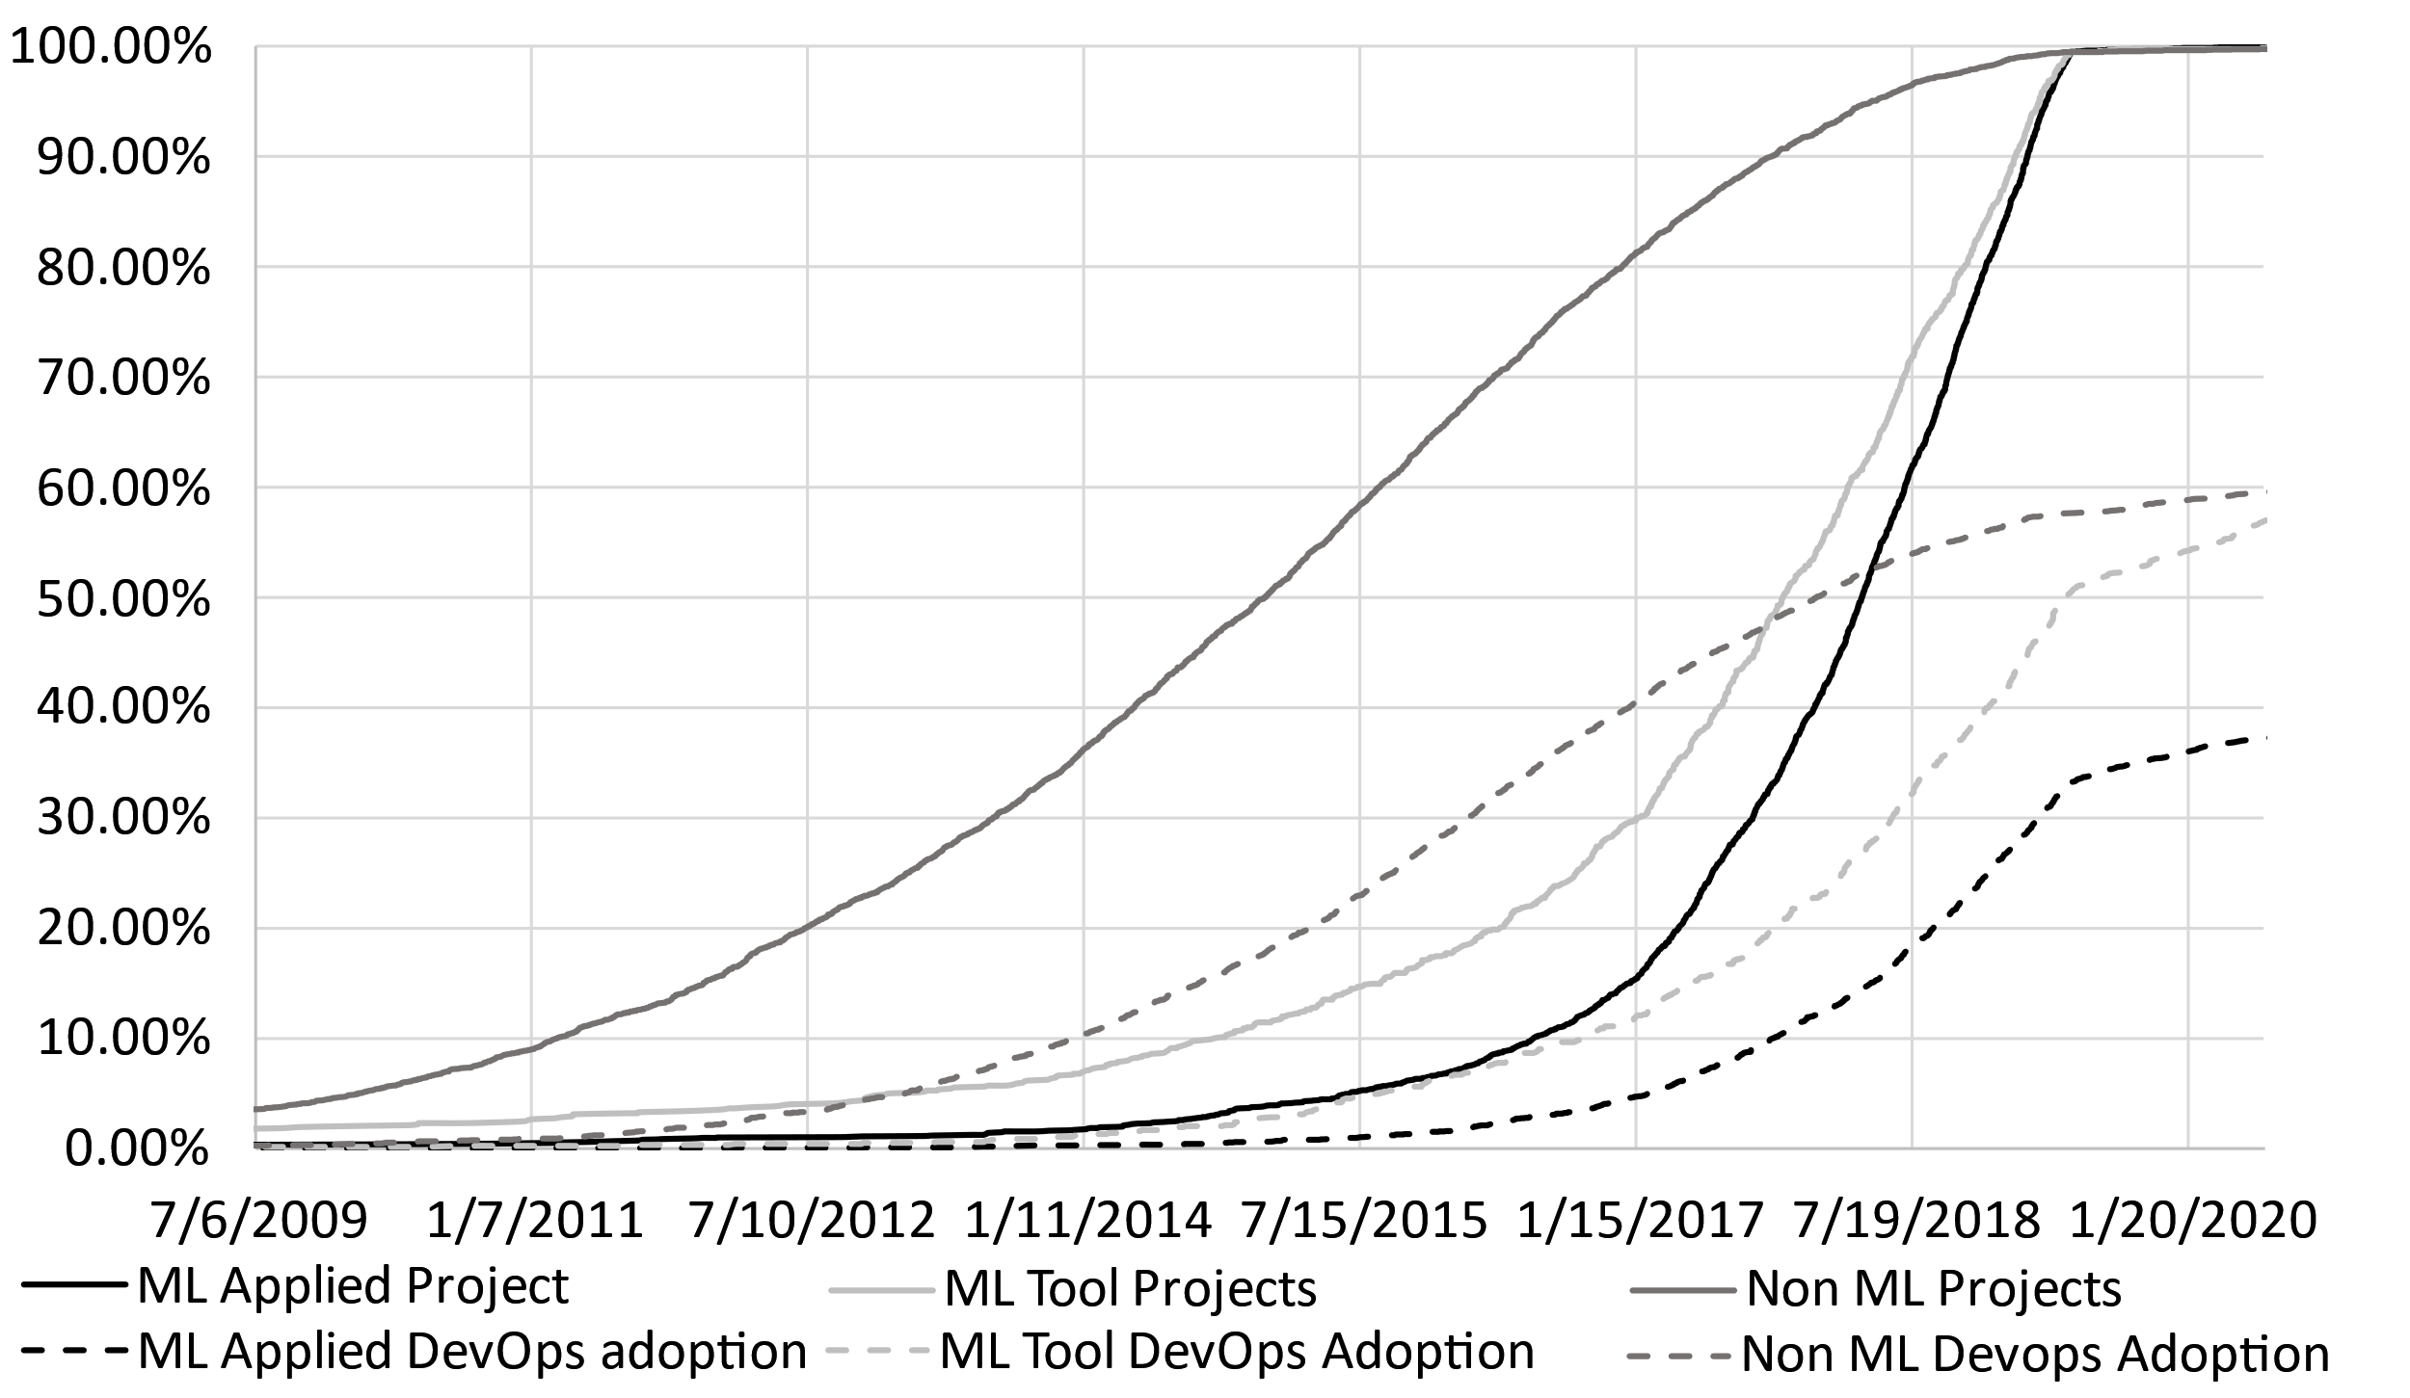
RQ1
Historical Adoption
Factors:
ML Applied: DevOps Adoption slow than project growth
ML Tool &Non- ML: DevOps Adoption similar to project growth
16

Slide 17
RQ2:What are the maintenance efforts
and goals associated with DevOps tools across
the different categories of projects ?

Slide 18
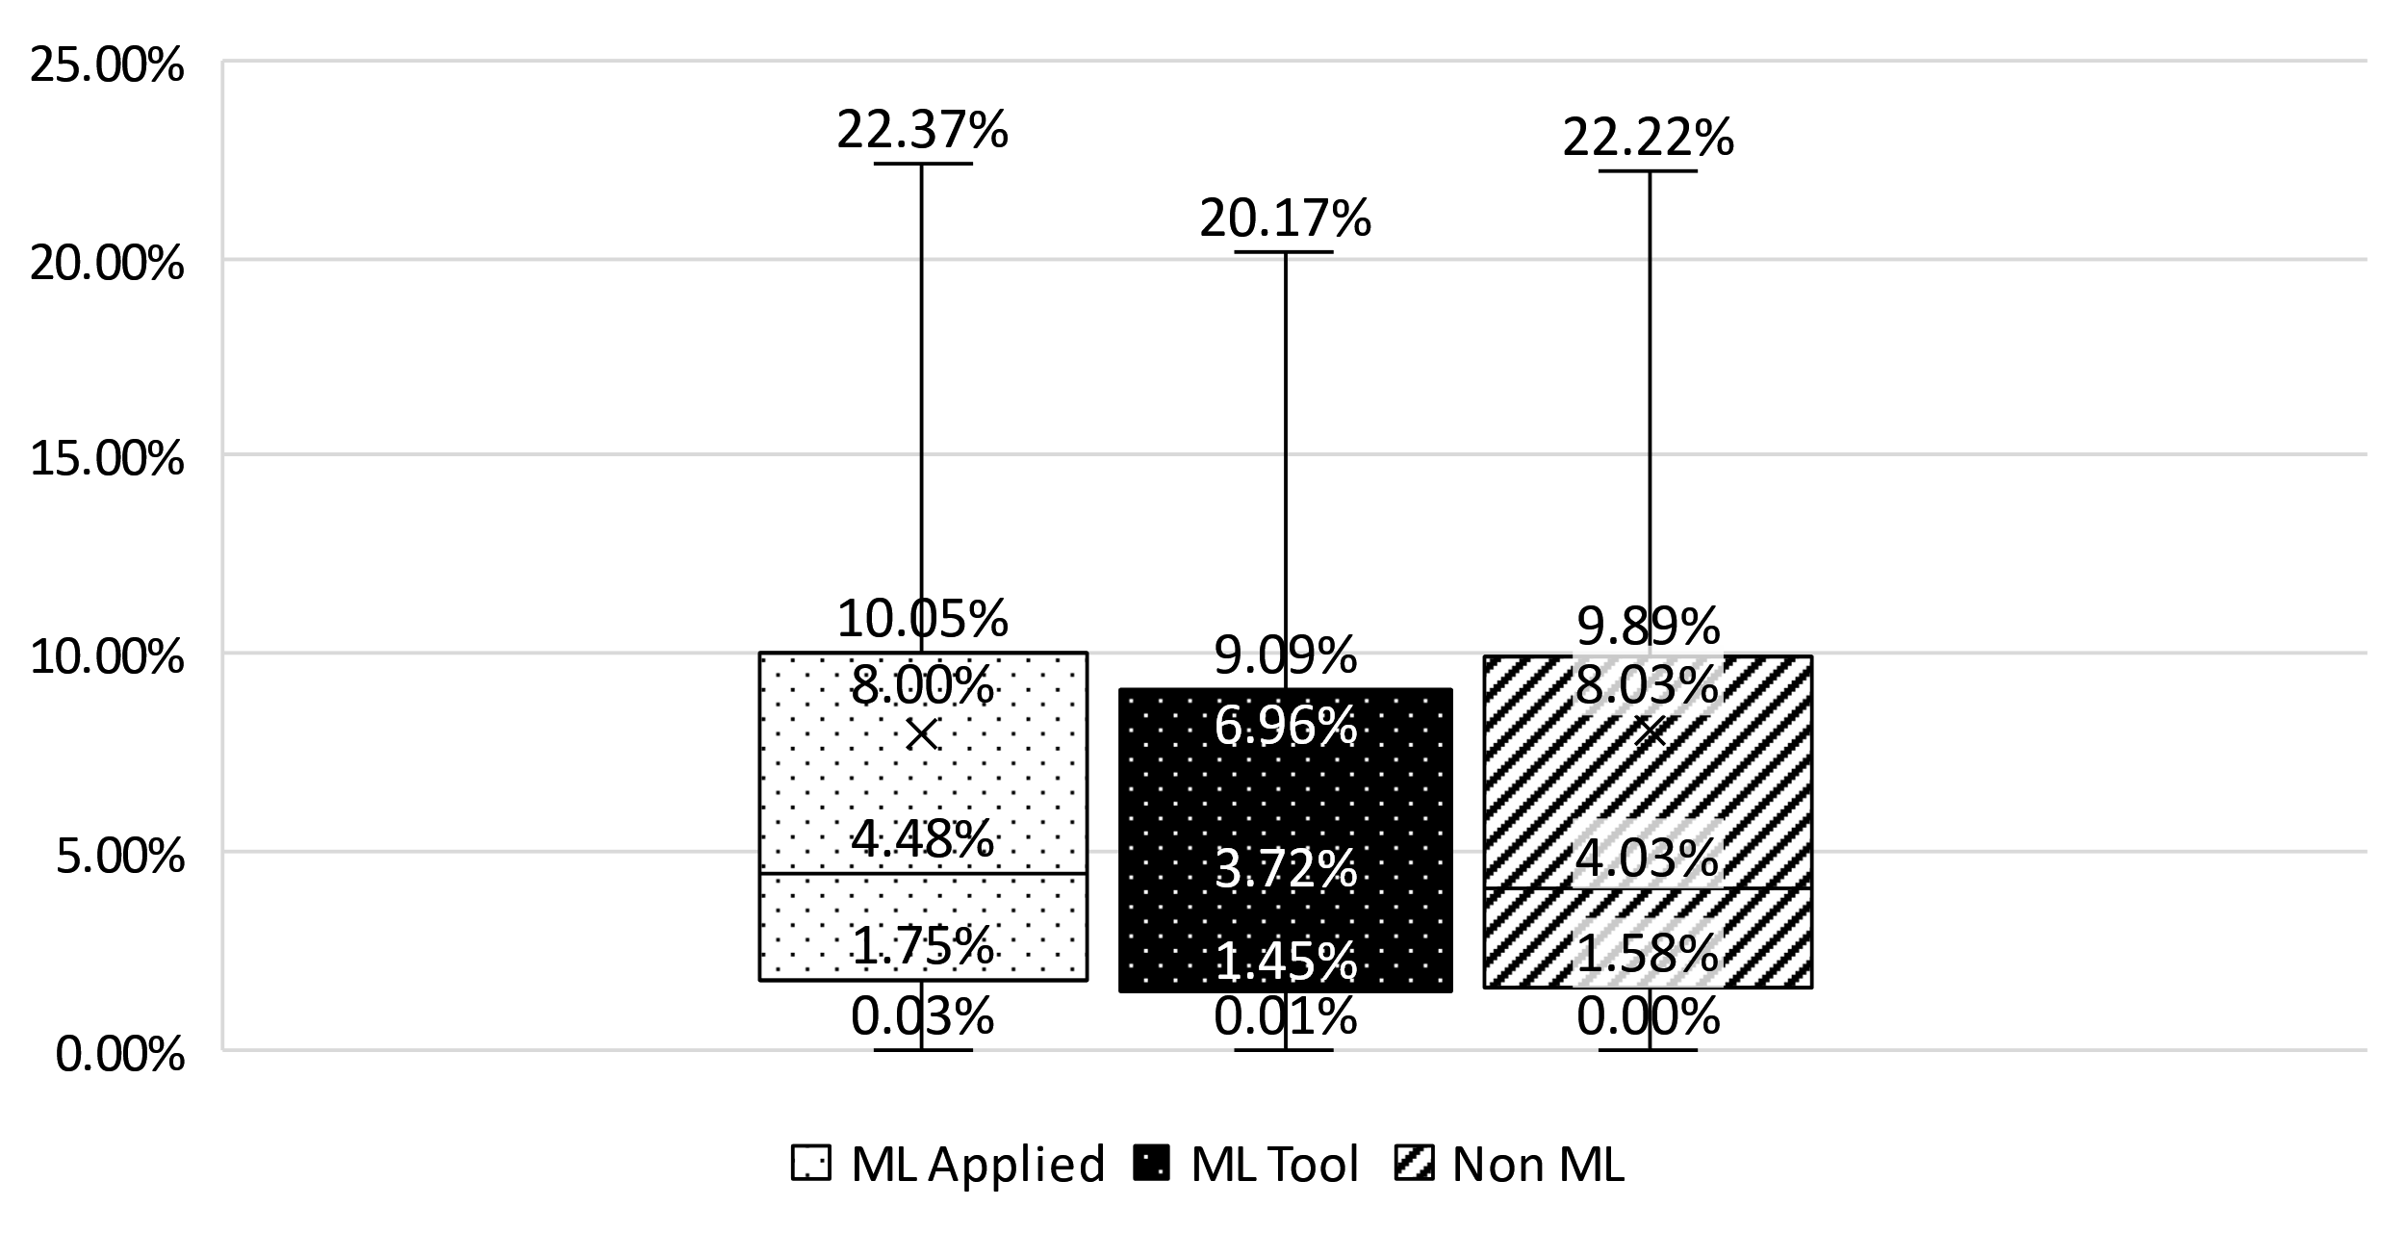
RQ2
Ratio of DevOps updates
Factors:
ML Applied: Adoption of combination of DevOps tools ( CI, CI & Build & Code Analysis) affect the commit ratio.
ML Tool &Non- ML: No effect
18
Notes:
These indicate they are doing more changes to their devops files depending on their adoption of which tools
Stand in contrast with the concept of “write-once-and-forget-it”

Slide 19
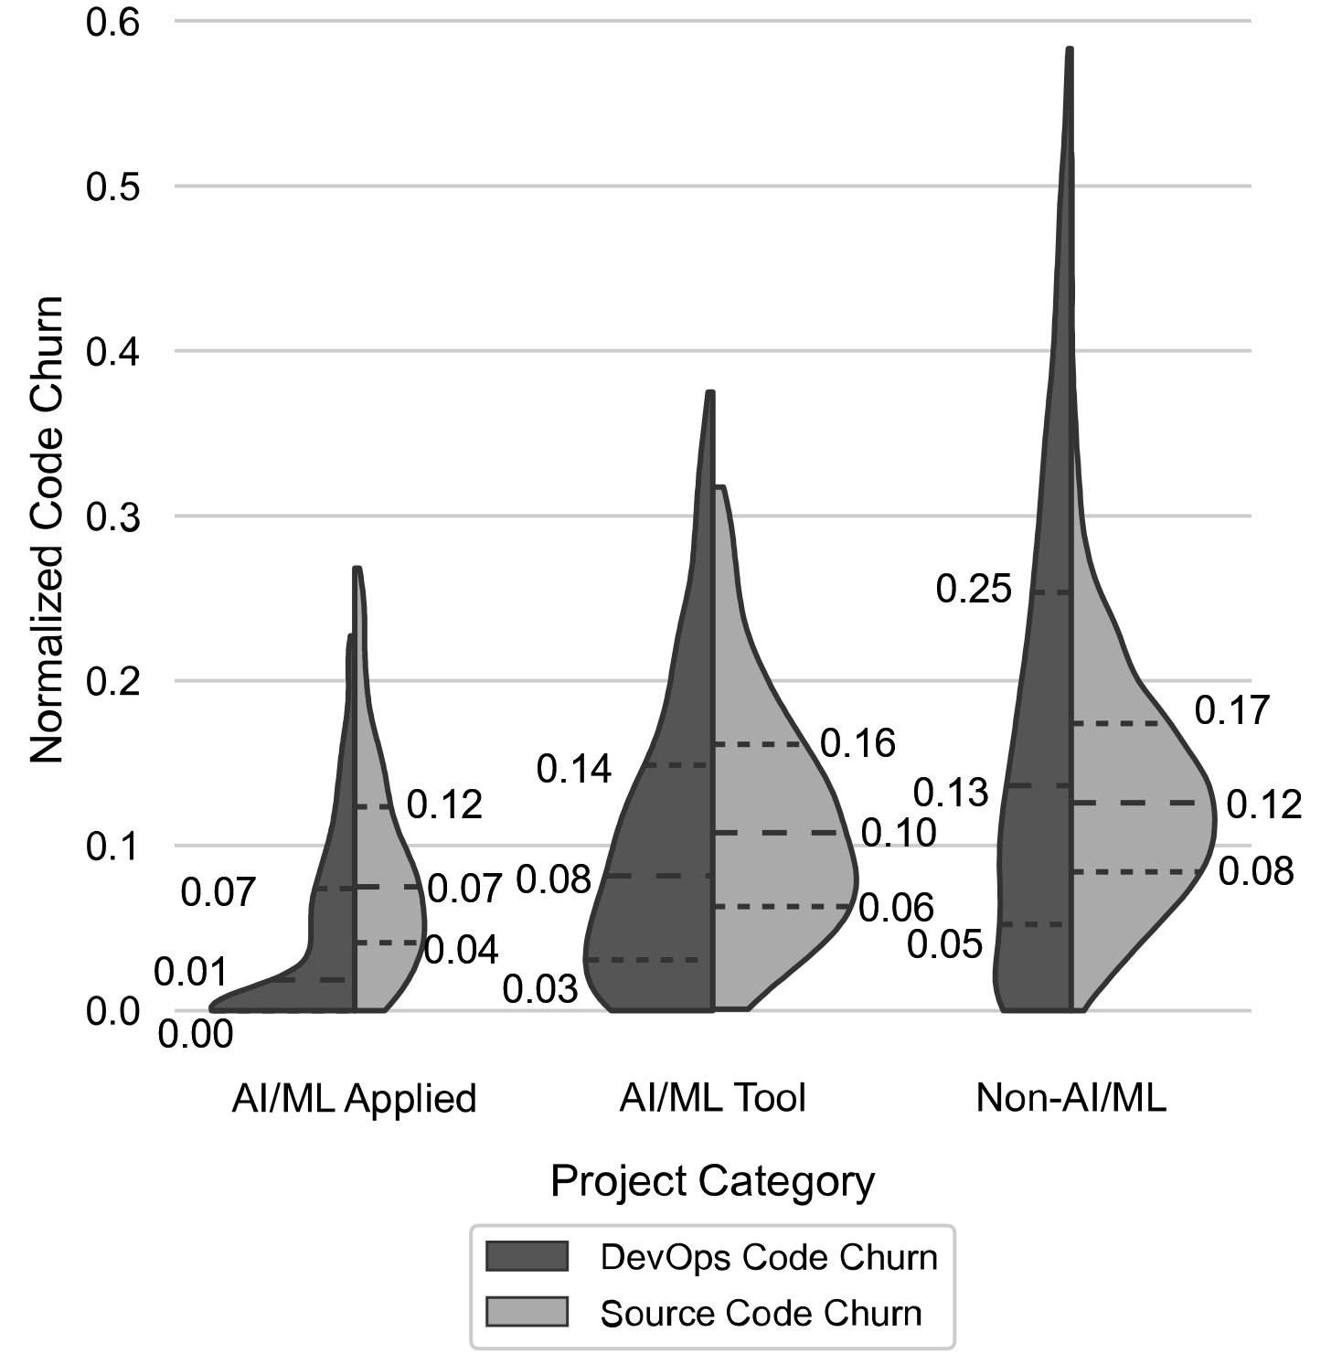
RQ2
DevOps files coding efforts
Factors:
ML Applied: Team Size, Age, Reliance on PR-based development, Adoption of certain DevOps categories
ML Tool: Adoption of certain DevOps categories, Number of Issues open.
Non-ML: Team Size, Reliance on PR-based development, Adoption of certain DevOps categories
19

Slide 20
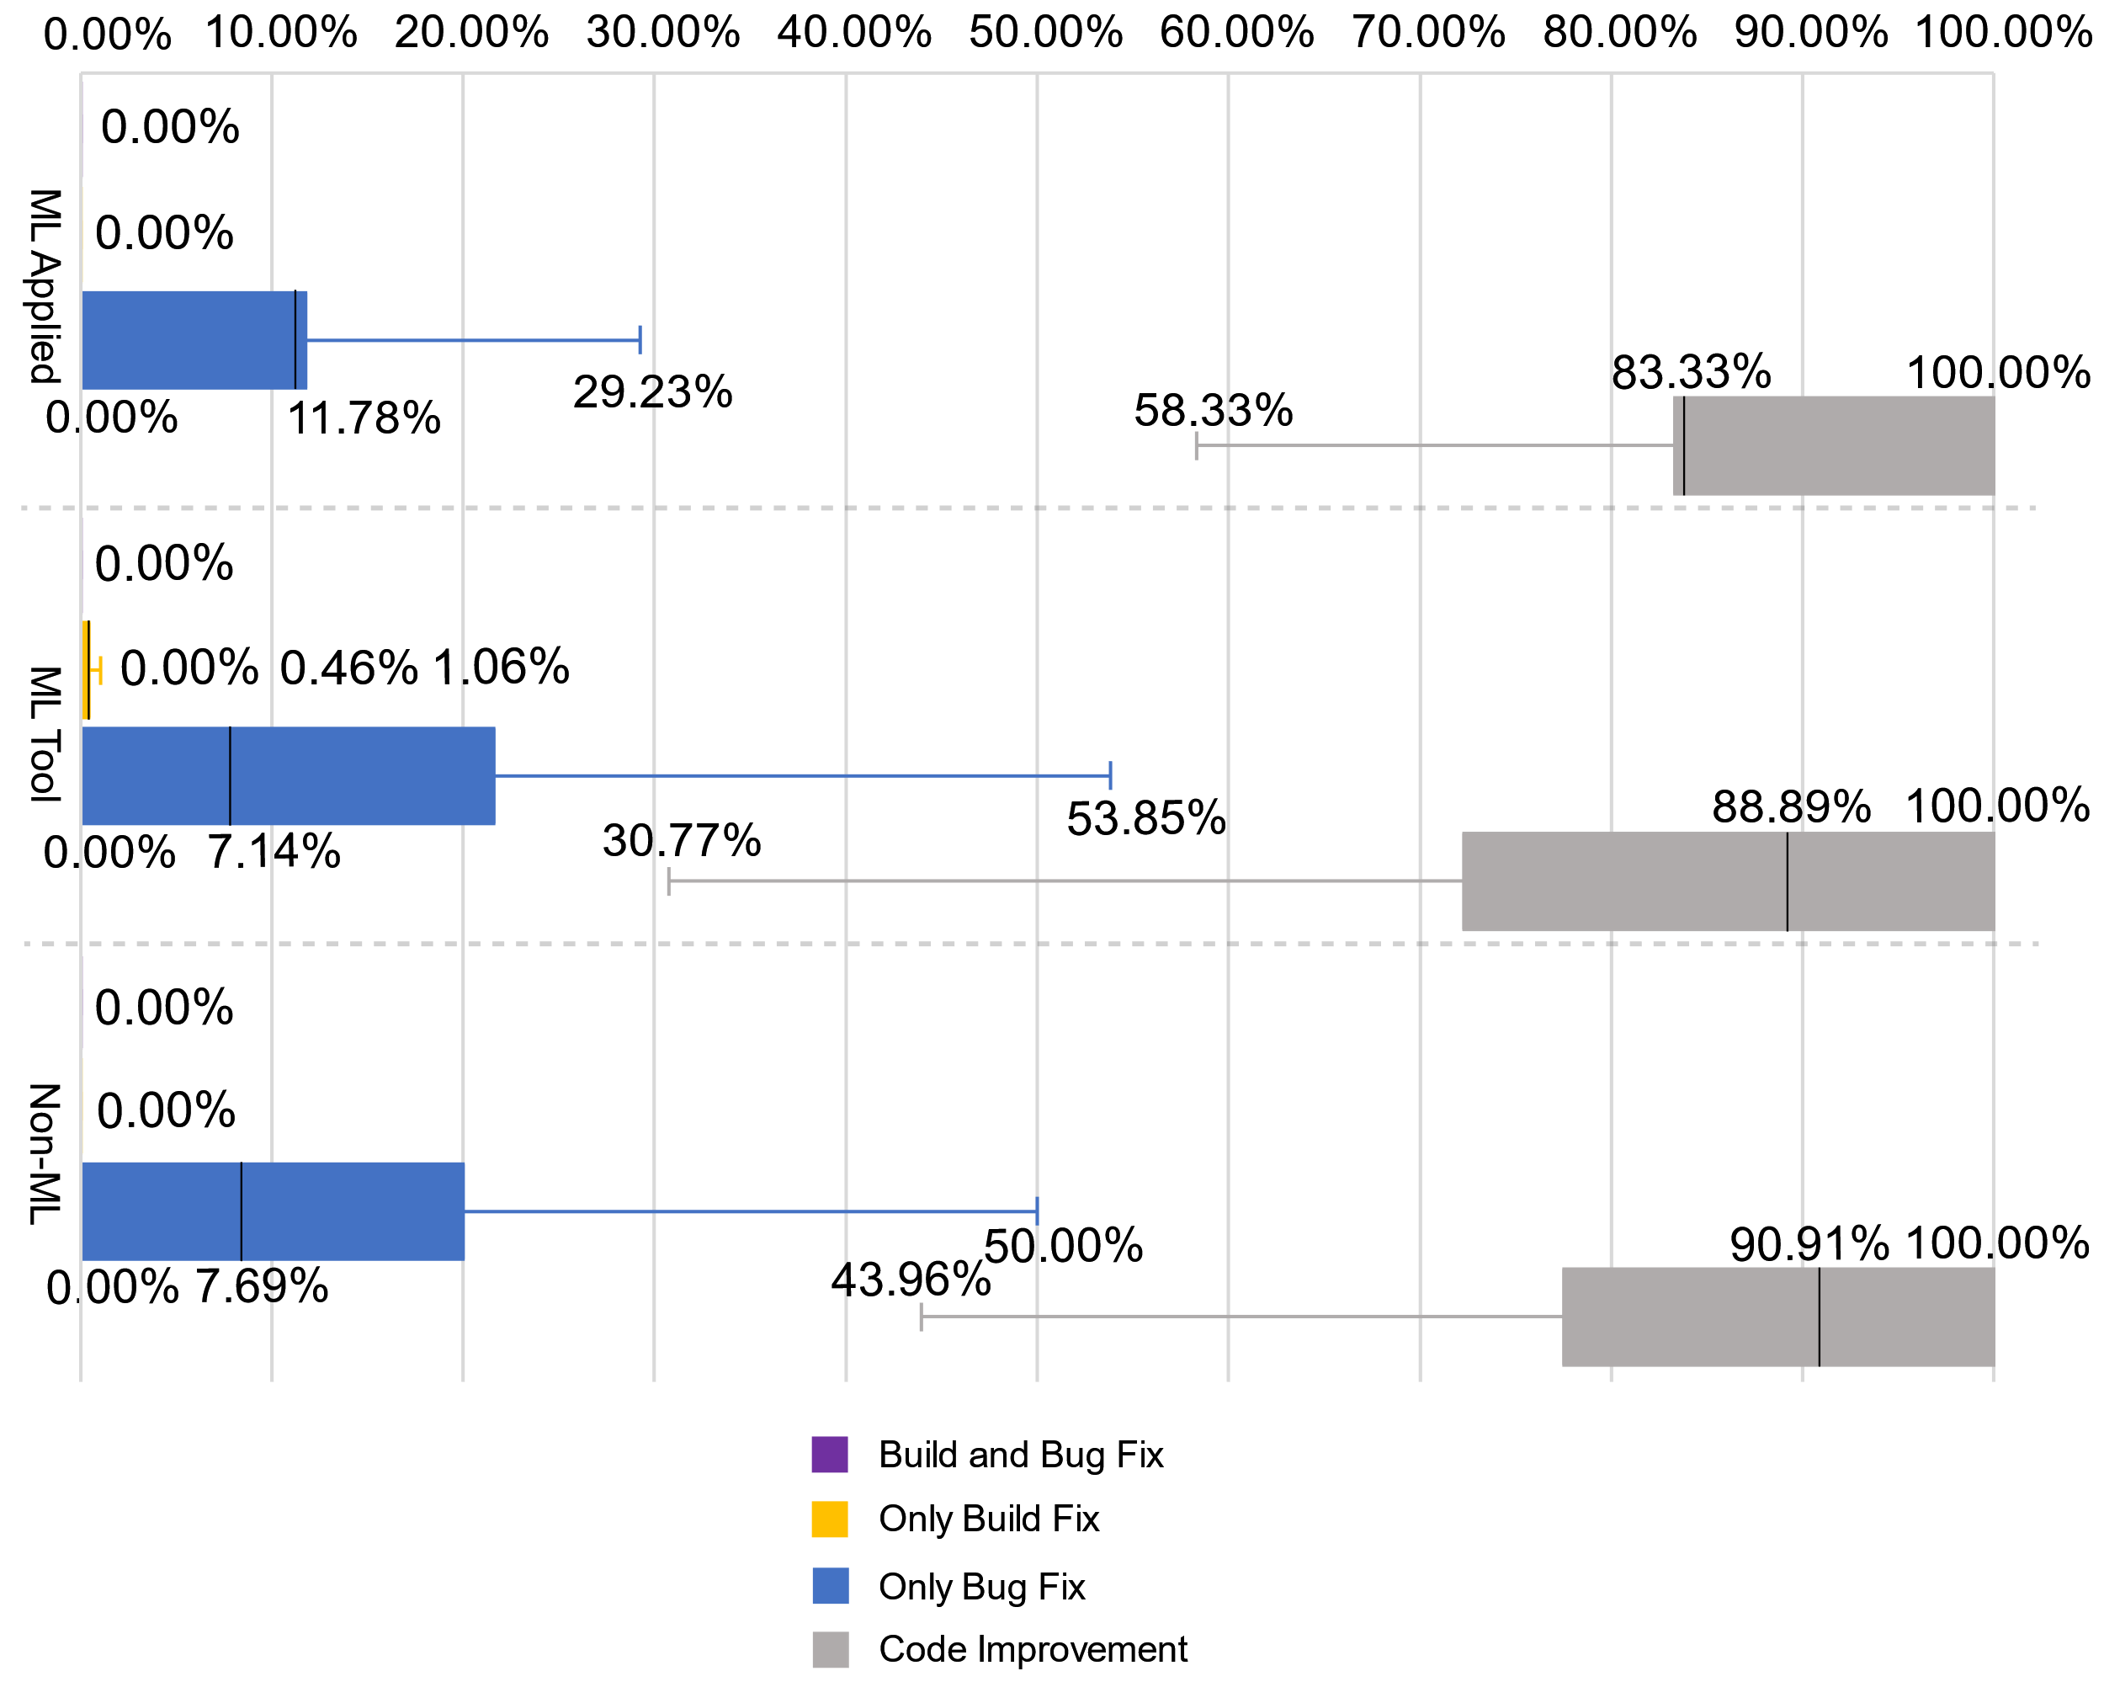
RQ2
DevOps usage goals
Factors:
ML Applied: No link was established
ML Tool, Non-ML : Adoption of certain DevOps categories is linked to higher bug fixes
20
Notes:
a correlation is found between the adoption of combination of Build, CI, Code analysis, Test and Deployment Automation within a project and bug-fixing commits being performed within it.

Slide 21
RQ3:What are the advantages of
adopting DevOps tools across the different types of
projects?

Slide 22
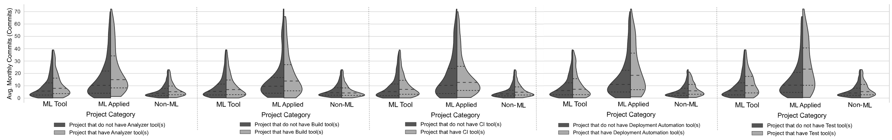
RQ3
Commit Frequency
Factors:
ML Applied: Adoption of DevOps has the largest effect on its monthly commits
ML Tool: Adoption of DevOps has an important effect, other factors have larger effect
Non-ML: Adoption of DevOps has an important effect, other factors have larger effect
22
Notes:
An ML Applied projects’ adoption of DevOps has the largest effect on its monthly commits. Other factors such as its Number of rejects PRs and Team-size also affect this metric.
An ML Tool project’s adoption of DevOps has an important effect on its monthly commits, however, other factors such as its Team-size have a larger effect on this metric.
A Non-ML project’s adoption of DevOps has an important effect on its monthly commits, however, other factors such as its Team-size have a larger effect this metric.

Slide 23
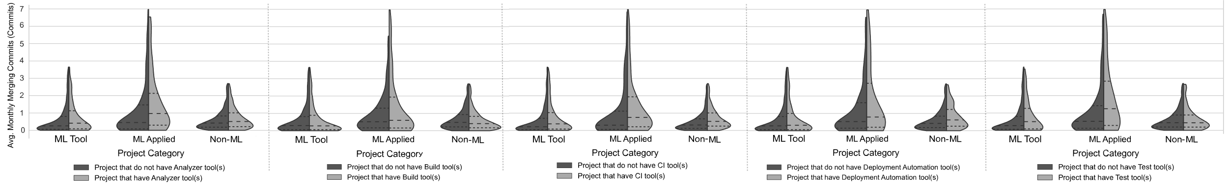
RQ3
Merging Frequency
Factors:
ML Applied: Adoption of DevOps has the largest effect on its monthly merges
ML Tool: Adoption of DevOps has an important effect, other factors have larger effect
Non-ML: Adoption of certain DevOps tools has an important effect, other factors have larger effect
23
Notes:
An ML Applied projects’ adoption of DevOps has the largest effect on its monthly merging commits. Other factors such as its number of stars and Number of Pull requests merged also affect this metric.
An ML Tool project’s adoption of DevOps has an important effect on its monthly commits, however, Team-size has a larger effect this metric
An Non-ML project’s adoption of certain DevOps tool categories at the same time, such as adoption CI, Code Analysis and Test tools, has an important effect on its monthly merging commits. However, its Teamsize has a larger effect this metric.

Slide 24
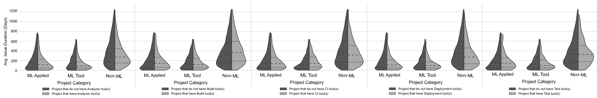
RQ3
Issue Duration
Factors:
ML Applied: Adoption of DevOps has an important effect, other factors have larger effect
ML Tool: Adoption of DevOps has an important effect, other factors have larger effect
Non-ML: Adoption of DevOps tools has an important effect, other factors have larger effect
24
Notes:
An ML Applied projects’ DevOps adoption helps it reduce its issue duration, however, other factors such as its numbers of issues open and its age have a larger effect on these durations.
An ML Tool project’ DevOps adoption helps it reduce its issue duration, however, other factors such as its numbers of issues open and number of PRs open have a larger effect on these durations.
A Non-ML project’ DevOps adoption helps it reduce its issue duration, however,
other factors such as its age and number of PRs open have a larger effect on these
durations.

Slide 25
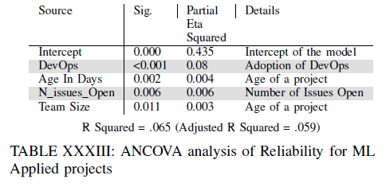
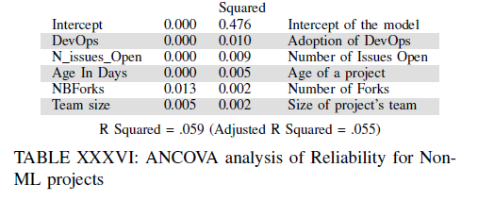
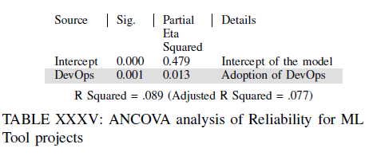
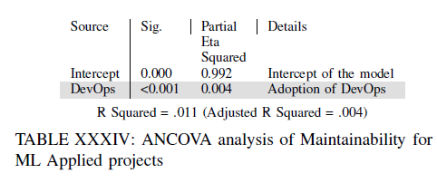
RQ3
Code Quality
Factors:
ML Applied: Adoption of DevOps has the most important effect
ML Tool: Adoption of DevOps has the important effect
Non-ML: Adoption of DevOps has the important effect
25

Slide 26
Results

Slide 27

111
Conclusion

Slide 28


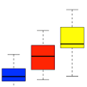

Conclusion
First large-scale empirical study on ML DevOps adoption, maintenance
effort and benefit analysis.
Different, less efficient developmet Practices of DevOps in ML Applied projects
Lower adoption of DevOps in ML Applied projects
ML Applied projects have the most to gain from adopting DevOps tool
28

Slide 29
Thank you for your attention!
Any Questions?
Corresponding Author :
Dhia Elhaq Rzig
dhiarzig@umich.edu
Dhiarzig.netlify.app

Slide 30

Implications

Slide 31






Implications
DevOps has a lower adoption in ML projects, why?
ML Applied projects would benefit the most from DevOps Conf. Auto sync
Co-evolution Analysis to analyze link between DevOps usage and bug fixes
31
Notes:
For Researchers.
First, while CI in ML projects has not received much attention from the research community, it’s adopted by up
to 37.22% of ML projects, showcasing its importance as a subject of study. We provide researchers with a set of CI-using ML
projects [26 ], in order to guide their work in developing and adjusting CI servers and tools for ML projects.
Second, Travis CI is the
best source of information regarding CI practices of ML projects, and based on our study, there is no evidence of the widespread adop-
tion of CI platforms specifically designed for ML projects. Thus, TraVanalyzer [ 26 ] is a great tool to further investigate CI prac-
tices in ML projects and can be easily extended to support other types of Travis-using projects, especially since we were able to
successfully use it in our set of Non-ML projects.
Third, we found some of the most frequent CI problems of ML projects were related
to test failures, test errors, and code analysis failures. Our Failure taxonomy and corresponding log analyzer can help with the au-
tomatic detection and debugging of these problems and guide the
development of Travis CI configuration repair tools

Slide 32
Implications

Slide 33
Overall Approach
33
Notes:
For RQ3. , API analysis for frequency, Log Analysis for taxonomy

Slide 34

Related works

Slide 35
Related works
Luz et al.[24] | Different approaches of DevOps adoption, its main concerns.
Leite et al.[6] | Conceptual mapping of DevOps and linking to engineering and management perspectives
McIntosh et al. [25] | Estimation of effort invested by developers to maintain functioning Build systems
Lwakatare et al.[11] | Outlining the problems of integration of ML workflows in DevOps processes and proposed alternatives.
Gonzalez et al. [20] | Large scale empirical study of collaboration and autonomy rates in ML software dev. teams.
Karlaš et al. [29] | Shortcomings of existing CI tools’ support of ML projects. Proposed approach to improve it.
35
Notes:
In contrast to existing works, our goal within this paper is to analyze the adoption rates and trends of all DevOps components
such as Code Analyzers, Build systems, Continuous Integration systems, etc., within ML projects, to characterize their associated maintenance efforts, goals, as well as the advantages they bring to the projects that adopt them.

Slide 36
Related works

